Slide 1
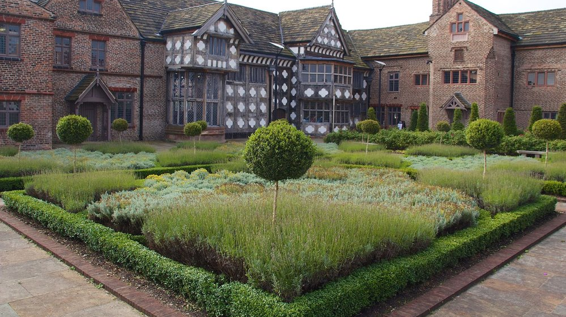
Sleeping Well at Ordsall Hall: Creating your Tudor Sleep Garden KS2 Schools

Slide 2
Teacher materials
You will need the following, taken from the KS2 Sleep Collage and Sleep Book images, and added to the end of this PowerPoint.
An A3 sheet of paper per pupil and colouring pencils.
You can additionally add coloured tissue paper, lolly sticks and other suitable items to recreate fully the collages in the video.
A selection of garden designs, so that pupils can choose their favourite.
A selection of plant/flower images for students to select, cut out and add to their design.

Slide 3
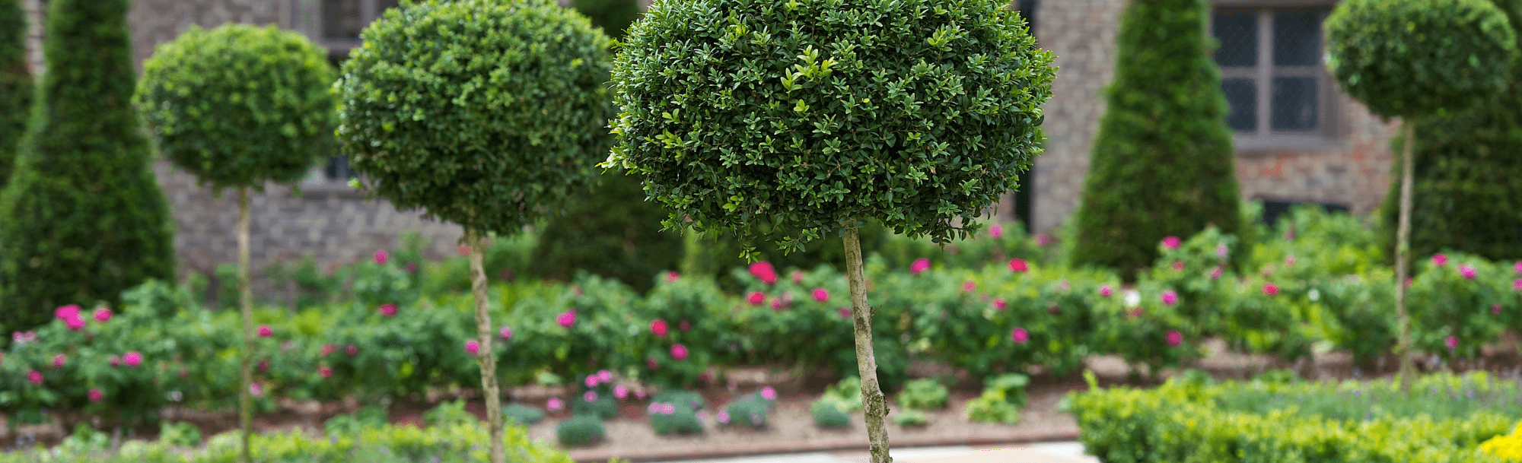
Tudor and Stuart Gardens
Unlike our gardens, Tudor and Stuart gardens were not only decorative spaces in which to play.
Instead, the plants, vegetables, herbs, and flowers in them, and in the surrounding fields, could be used to make bedding materials, remedies, foods, and scents to keep themselves healthy, control their bedroom environment, and be ready to sleep well.

Slide 4
Planning the Garden
Tudor and Stuart lives were very sustainable: they were able to grow much of what they needed to live and sleep.
In the winter, when there wasn’t much growing the garden, a family like the Radclyffes of Ordsall Hall would need to plan:
What to grow in their gardens and fields for the coming year
Where to plant things
Create a good stock of supplies they had preserved throughout the spring, summer, and autumn.
Following the steps below, you are now going to do the same.

Slide 5
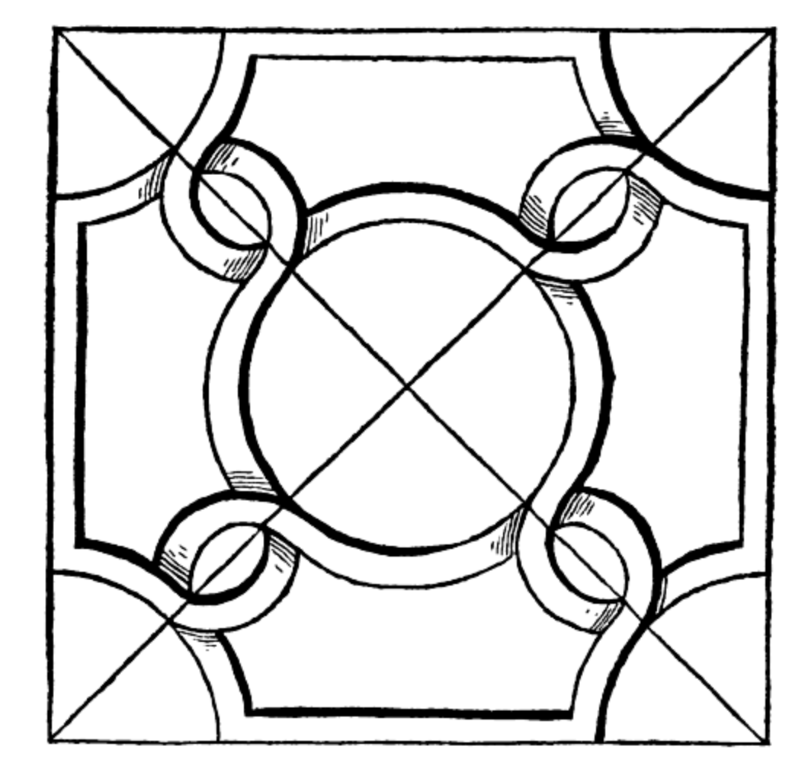


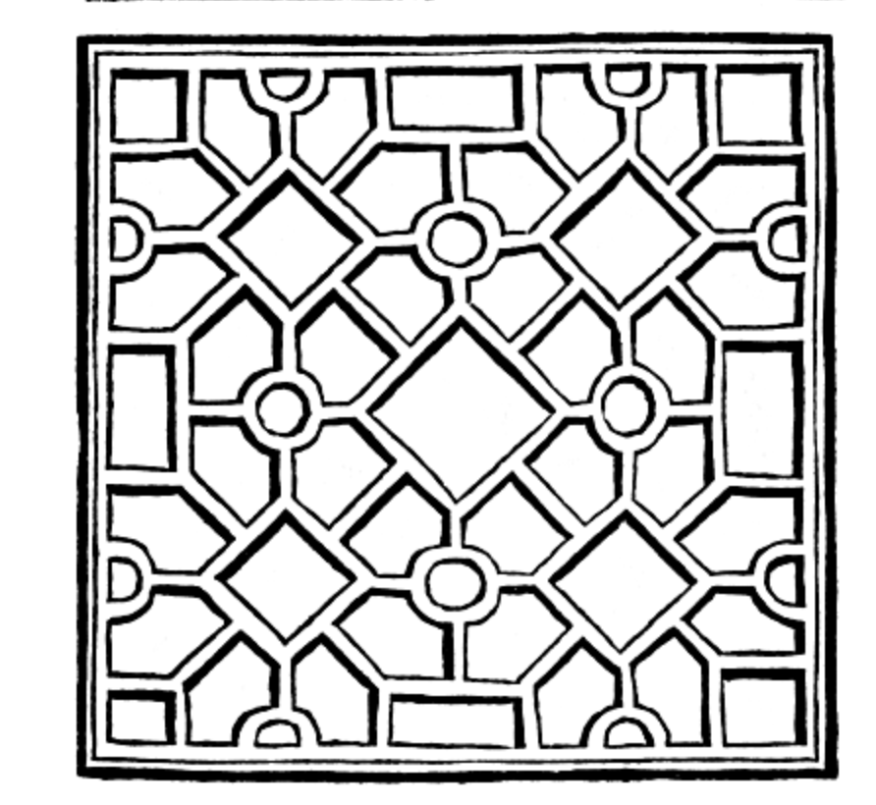
1. Select your garden.
Make sure that you have space surrounding your garden to add some fields for sheep and cattle.

Slide 6
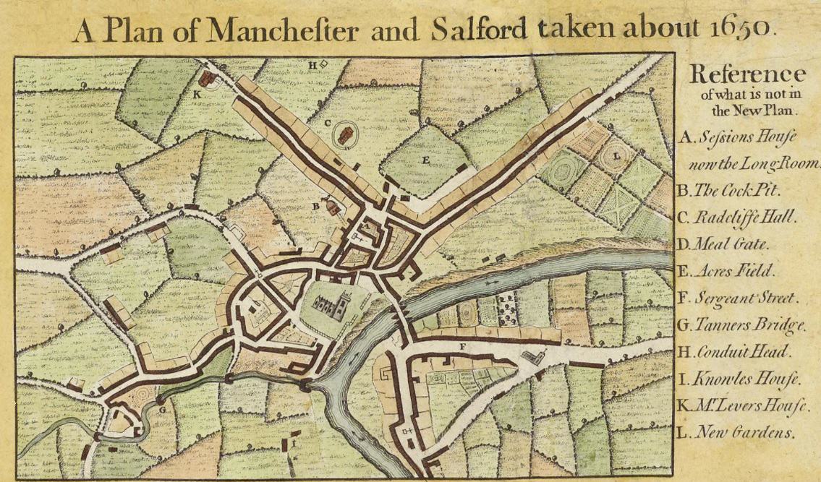
2. Add some fields surrounding your garden.
This is Ordsall Hall on a map of Manchester and Salford from around 1650. It is surrounded by fields which would have provided food and bedding for the inhabitants!

Slide 7



2. Add some fields surrounding your garden.
Your field boundaries don’t need to be perfect – just create some big spaces that you can come back to (about 4 or 5 is ideal).

Slide 8
3. Decide which herbs and flowers to grow
Play video: ‘Sleepy Garden Collages’ to 01.03.
Tudor and Stuart sleep remedies included plants, herbs and spices such as rose, lavender, camomile, fennel seeds, lettuce and lemon balm. These helped people to feel relaxed and calm and were believed to bring on sleep.
Lavender and rosemary also helped reduce bedbugs, which would have made people itchy – not an ideal sleep experience!
All of these ingredients worked through the scents they produced, the feelings they caused on the skin, or the effect they had when they were eaten. Select 3 of the above and stick them on your garden.

Slide 9
4. Make sure you have cooling and warming plants.
Don’t forget that your flowers and plants will be dried so that they can be used all year round! Tudors and Stuarts believed in the four humours – and that your body was either hot or cold, so it was important to balance the body. If you were hot (e.g. summer) or had a fever, you would require cooling remedies. If you were cold (e.g. the winter), you would require warming herbs.
Tudors and Stuarts believed that some plants were more suitable for cooling:
Rose and violets could be used in washing waters to cool the head, arms, and legs before bed. In the summer Cucumbers could be used to wash your hands and face with before bed.
They also believed that some were more suitable for warming in winter or if you felt cold:
Warm herbs like lavender could be heated to clean and warm the air and stop bad smells that were believed caused illness. Chervil and lovage warmed the stomach and helped digestion.
Select 2 cooling ingredients and 2 warming ingredients. Stick them on your garden.

Slide 10
5. In your surrounding fields, you now need to add some crops and other features.
Play video: ‘Sleepy Garden Collages’ from 01.03 to 02.06.
Blankets and covers were all made from materials from nature:
Flax fields: Flax was turned into linen. Dried flax fibres were spun on spindles and spinning wheels before being woven into fabric for bedsheets, night gowns and night caps (and day clothes). Flax seeds were also used in sleep remedies.
Grazing: sheep provided wool stuffed straight into mattresses (as well as meat for meals).
Mattress stuffing could also be made from:
Wheat and oat fields: Wheat straw or the ‘chaff’ left after oats were harvested.
Duck feathers
Moss and fluff from bullrushes that grew in boggy wetlands.
Other areas to include might be:
Barley fields were also important: barley water was used for lots of sleep remedies.
Orchards full of fruit trees: pears and apples were cooling, so could be eaten in the summer. In winter, spices were added to make them warmer, so balancing the body
Now decide what you will add to your fields: flax field, barley field, grazing area for sheep and cattle, orchard, a stream and a bogland for wetlands. Add your own pictures and label your fields.

Slide 11
6. In your surrounding fields, you now need to add some crops and other features.
Calming spaces are important for everyone! What makes you calm and relaxed when you are outside?
Play video: ‘Sleepy Garden Collages’ from 02.53 to end.
Finally, add one or two areas from the below:
Green spaces: An area with some birds so you can hear relaxing bird song might be a good idea. Green spaces could be used for exercise but also for calm reflection and meditation.
A relaxing space to sit in, planted with nice smelling flowers and herbs. Roses and borage were believed to be happy flowers that cheered people up. Your garden should make you feel happy and soothed as well as provide what you needed in the 16th and 17th centuries to help you sleep.
Have you got a watery area? Some water for water lilies and bullrushes to grow in, to use for sleepy remedies or to stuff your pillows, might be combined with a gentle river to create some soothing sounds.
Colour in the rest of your garden, or adding any additional coloured paper, ribbons or other materials your teacher may provide.

Slide 12
Garden templates

Slide 17
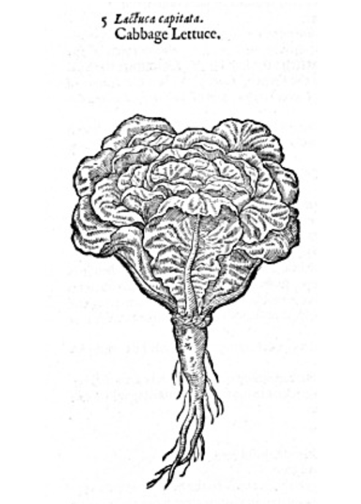
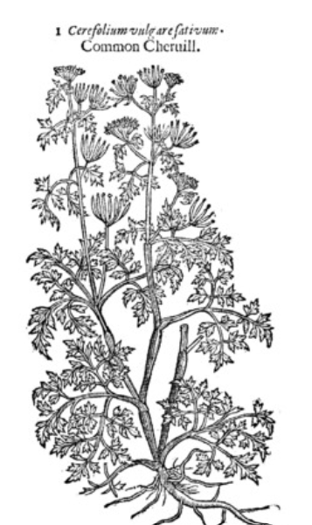
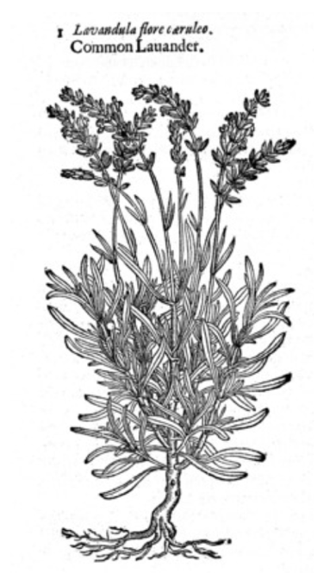
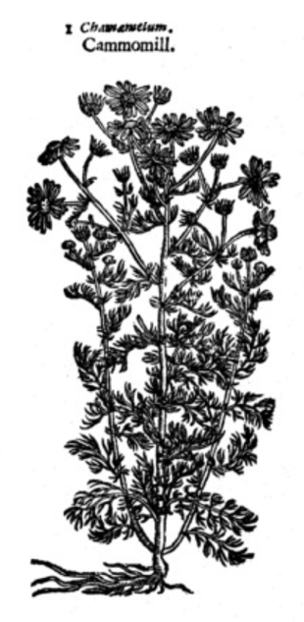
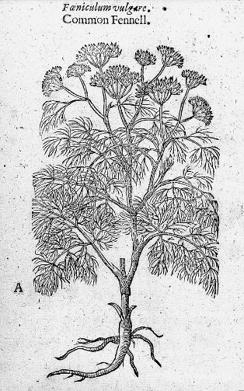
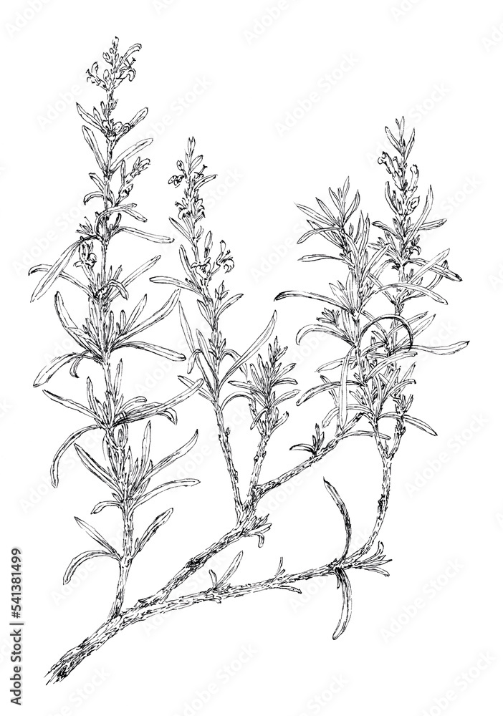
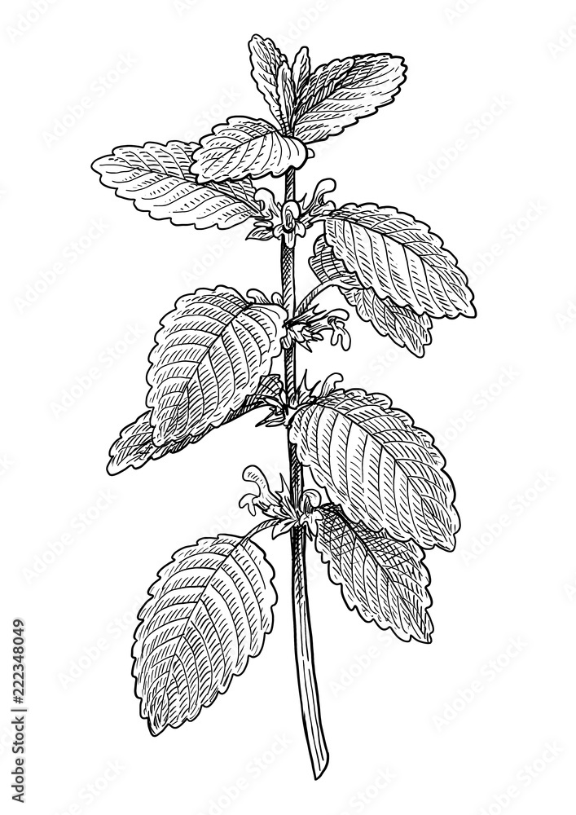
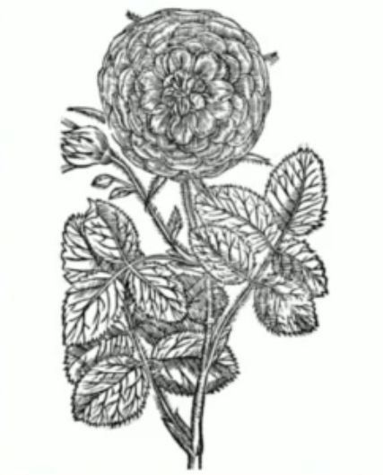
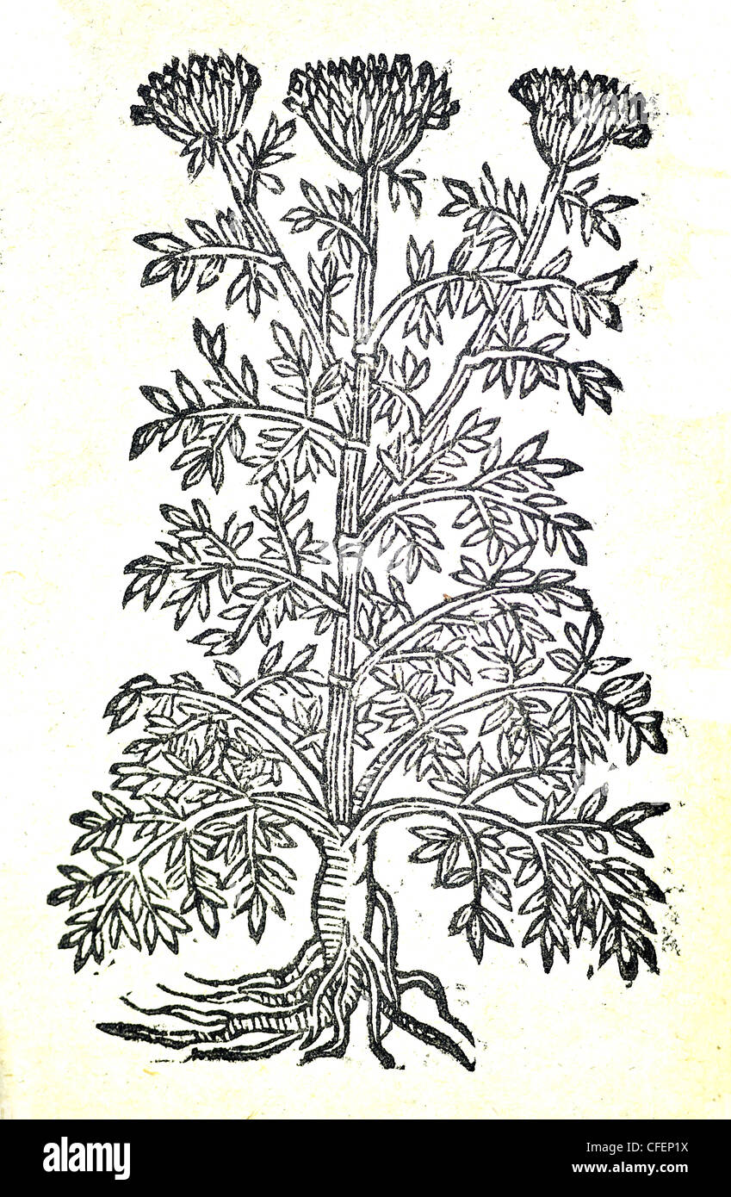
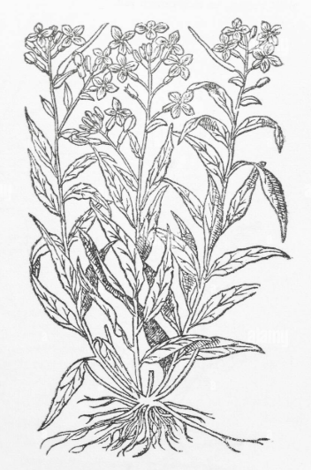
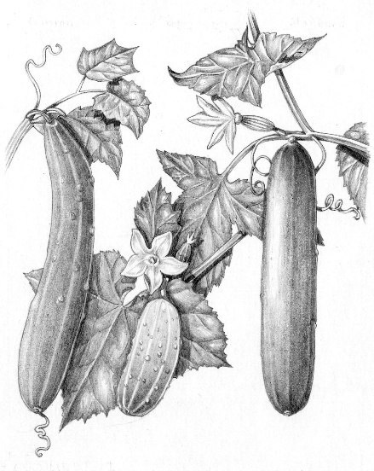
Sleepy garden plants
Violet
Cucumber
Lovage
Rosemary
Lemon Balm
Rose

Slide 18
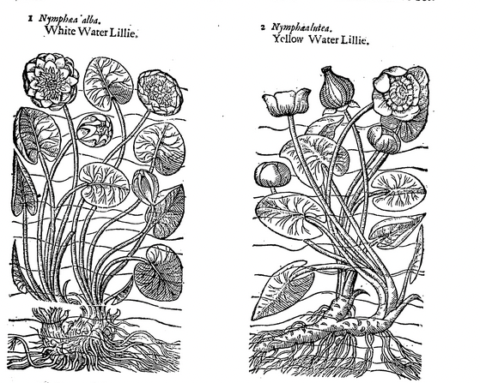
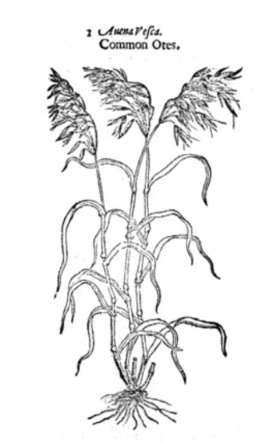
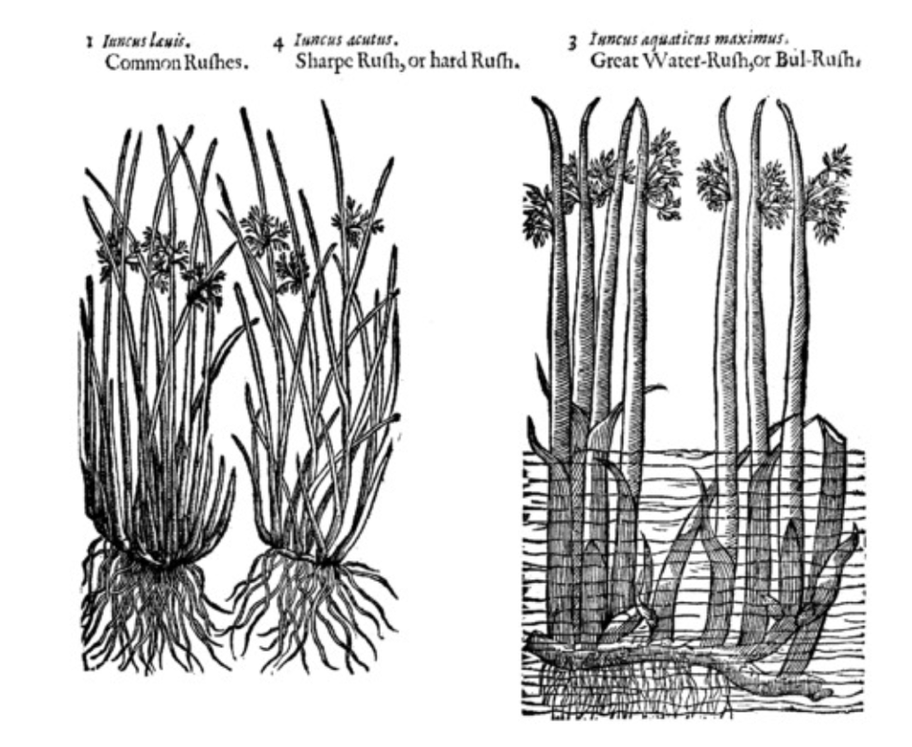
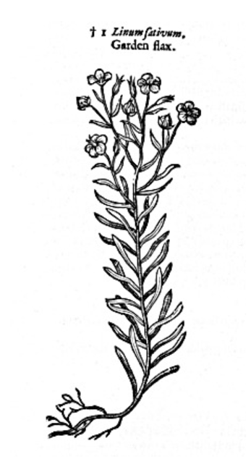
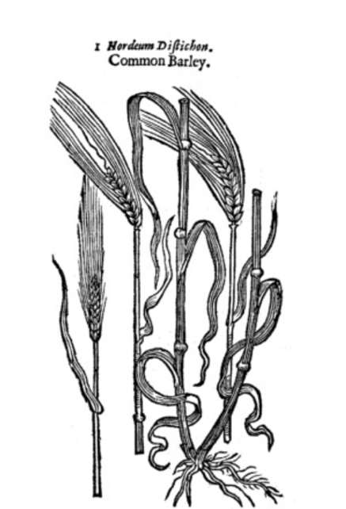
For the areas surrounding your garden

