Slide 1
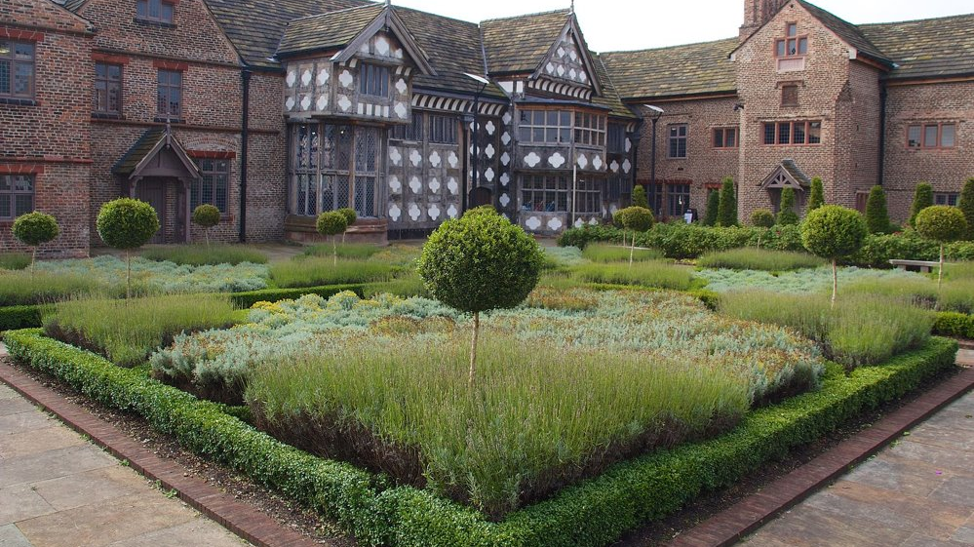

Sleeping Well at Ordsall Hall
Introduction: Healthy Living and Healthy Sleep
Key Stage 2 Schools

Slide 2
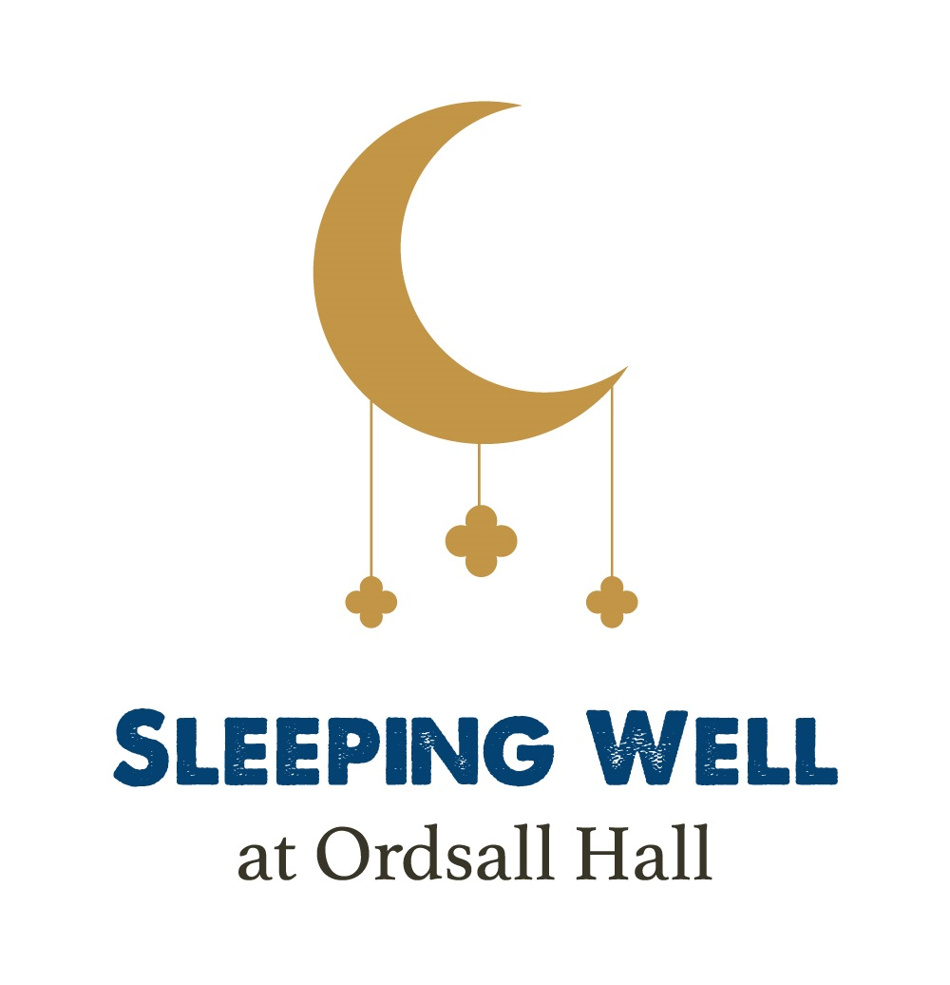
Living and Sleeping like a Tudor
Ordsall Hall, Salford, home of the Radclyffe family
The Tudors and Stuarts knew that a good night’s sleep was an important part of staying healthy.
They looked after their sleep by paying attention to their bodies, minds, and the natural environment all around them.

Slide 3
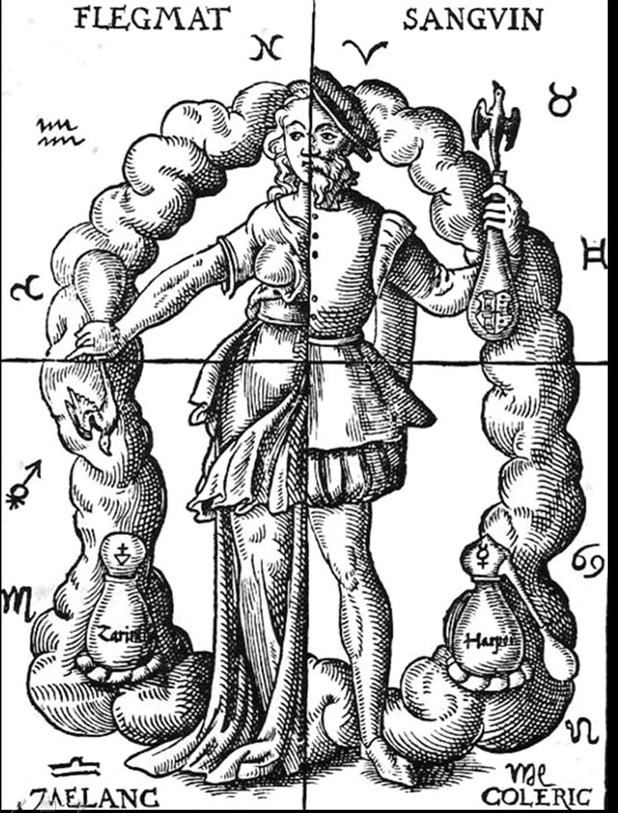
The Four Humours
Tudors and Stuart doctors did not know much about how people’s bodies functioned from the inside.
Instead they developed their knowledge of how to look after their patients’ bodies from what came out of them!
Tudors and Stuarts saw bodies as divided into four ‘humours’ – gases and fluids they thought moved around their bodies.
Blood
Phlegm
Choler
Melancholy

Slide 4
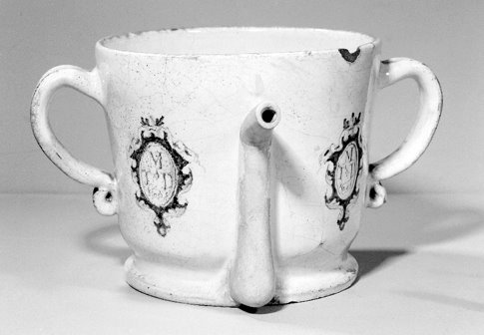


The Six Non-naturals
Balance in everyday life was thought to keep people healthy
  Sleep
  Food and drink
  Exercise and rest
  Air
  Excretion and retention
  Passions of the mind
Posset pot

Slide 5
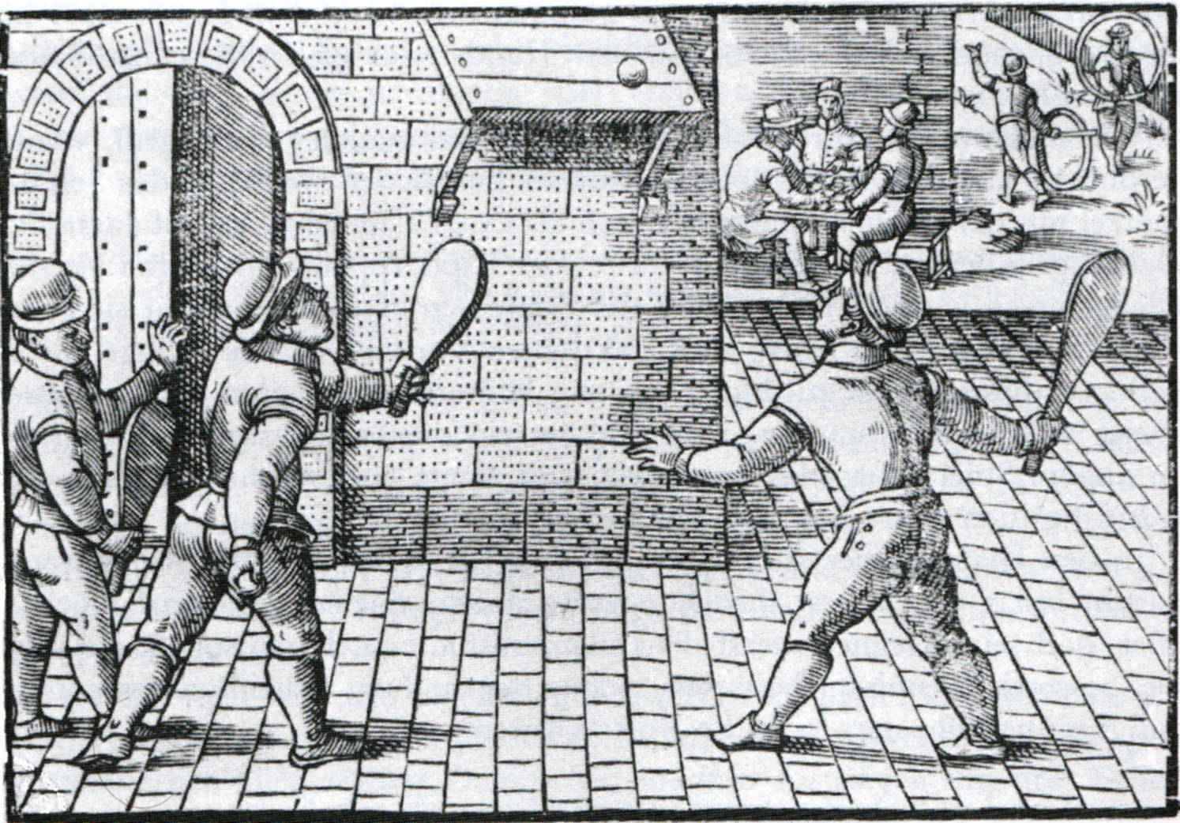
Balanced Lifestyles
Think about these questions
as a class:
  Do you sleep well?
  Is your diet healthy?
  How much time do you spend outdoors?
  What do you do to relax?
  How do you look after your emotional health?

