Slide 1


Sleeping Well at Ordsall Hall: What made a good night’s sleep in the Tudor and Stuart periods? KS2 School Resources

Slide 2
What helps you to have a good night’s sleep?
Routine: What do you do before you go to bed? How might that help you?
Comforts: What do you take to bed with you? What else helps you feel cosy and comfy at night?
Exercise: Why might exercise during the day help you sleep at night?
Is there anything that you think you shouldn’t do before bed that might make it harder to get to sleep?

Slide 3
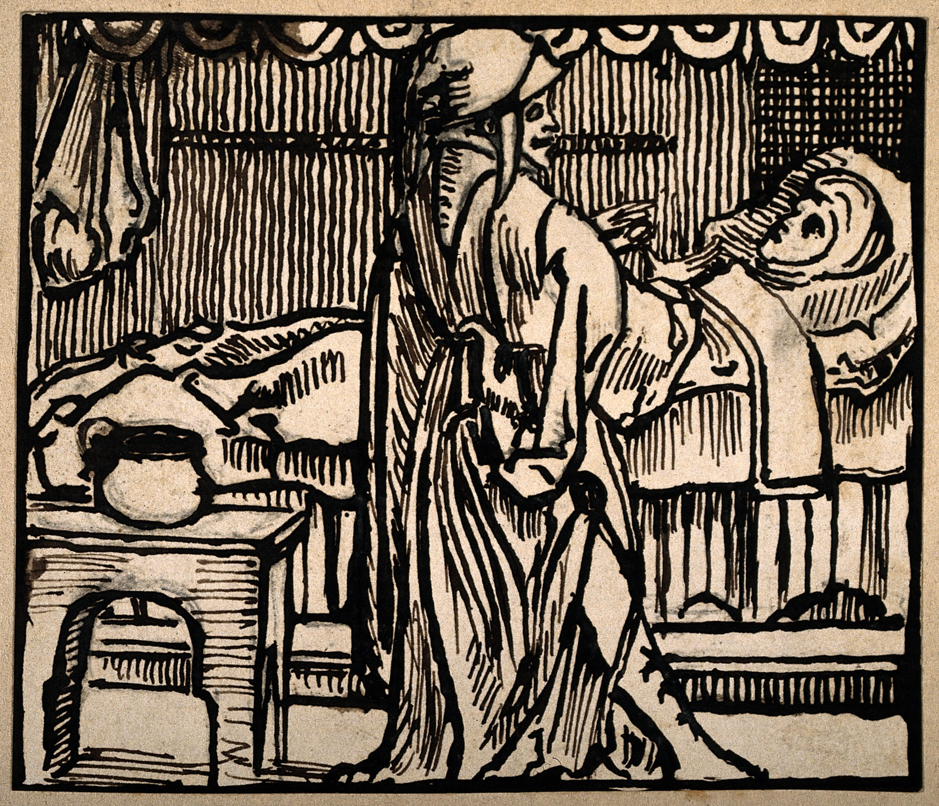
Sleep in the Tudor period
Just like today, getting a good night’s sleep was an important part of a healthy life.
Good sleep meant keeping the body balanced through good habits.
Tudors understood bodies in a different way from us. They thought that bodies were made up of 4 types of gases or liquids (the humours) and it was keeping these in balance kept people healthy.

Slide 4




Getting ready for sleep
Which of the choices below do you think would be more likely to help you sleep?
Milk
Flowers and herbs
Relaxing activities
Cabbage
Beans
Too much excitement

Slide 5






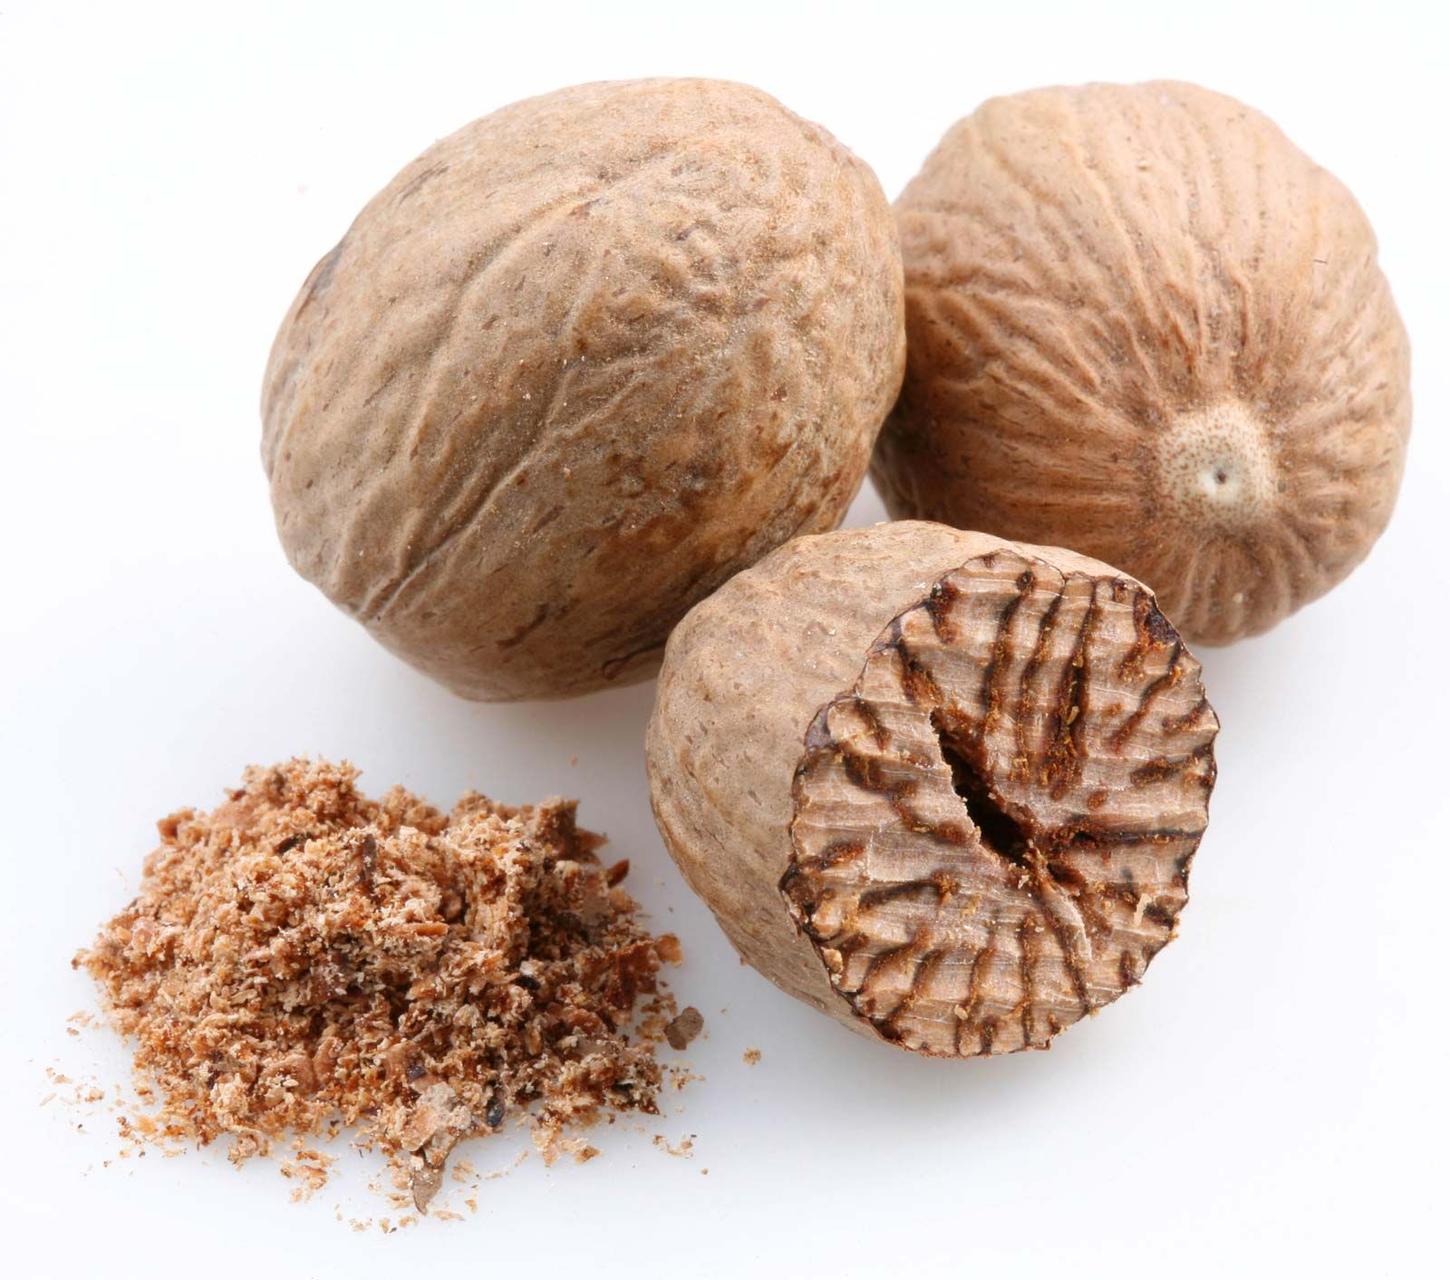
Good smells meant good sleep!
Which of these flowers and spices have you seen (and smelled)?
Roses
Lavender
Camomile
Lemon balm
Cinnamon
Nutmeg

Slide 6
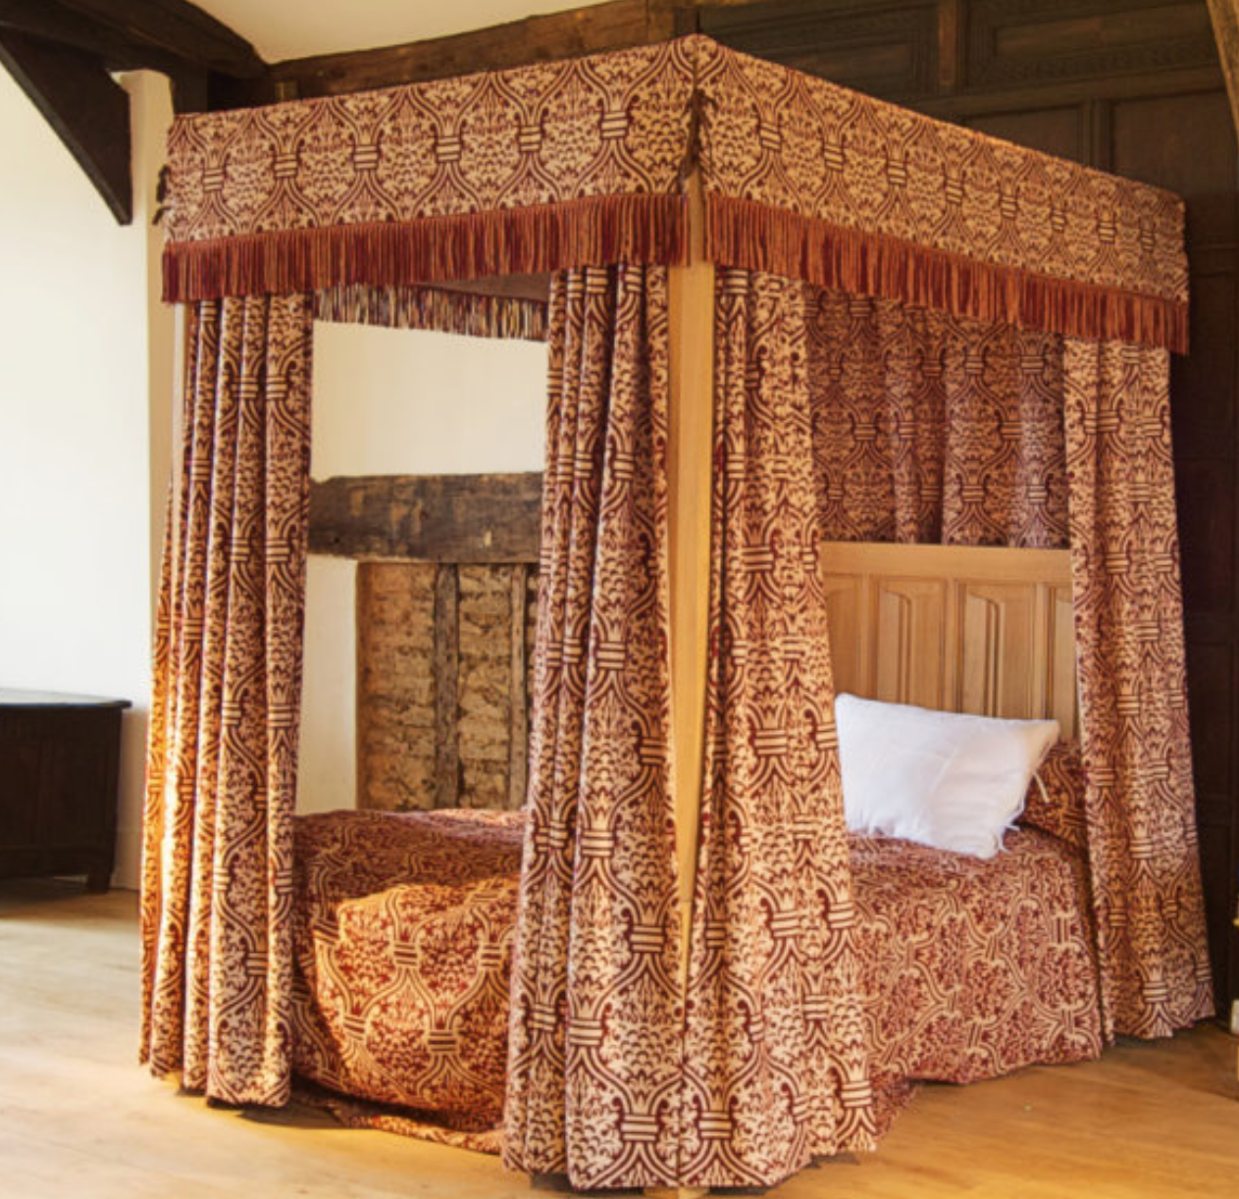
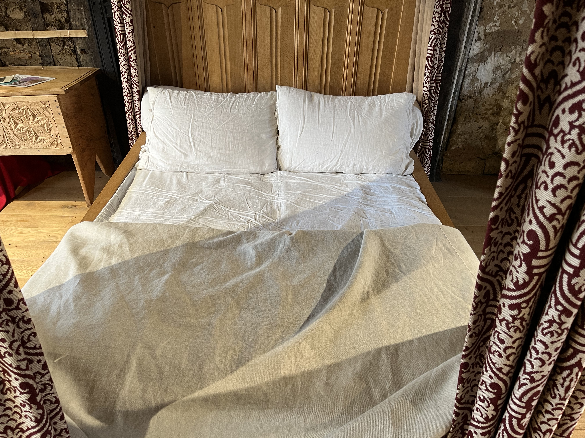
Getting comfortable
Teachers! Before playing, please see teachers’ note.
What do you think made this Tudor bed at Ordsall Hall so comfortable?
You might also like to look at this resource on Tudor beds: Tudor Beds at Ordsall Hall - Salford Museums Schools' Hub
Notes:
TEACHERS NOTE: please note mention of Tudors believing in evil spirits at bedtime in this slide.

Slide 7
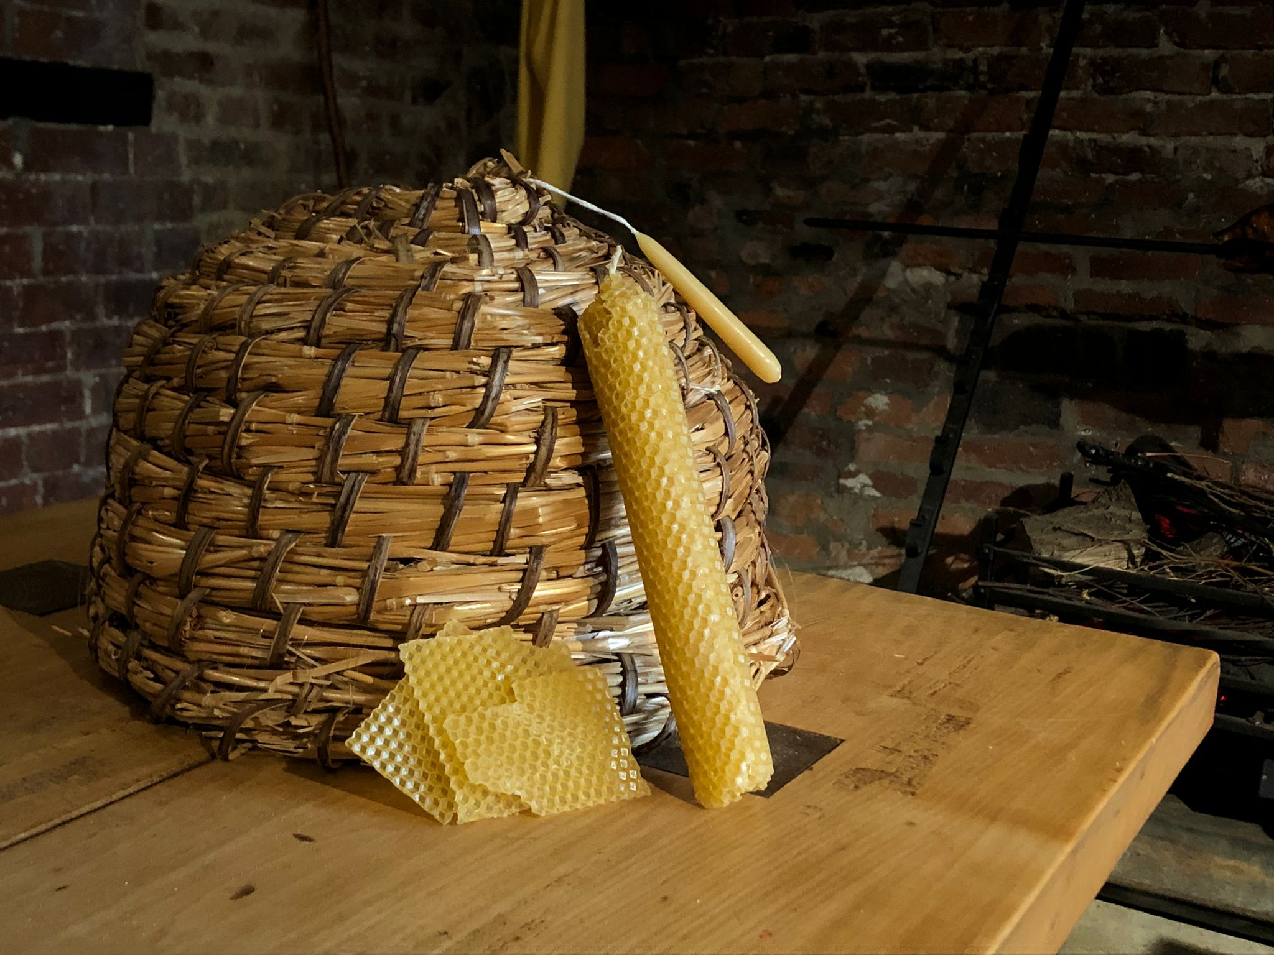
Sleep Tips and Next Steps
Which of these Tudor sleep aids could still work for you today?
Cooler bedrooms
Lettuce
Herbs and flowers
Sleepy drinks
Low light
Try some activities where you can explore some of this historical advice and learn more about Tudor and Stuart approaches to sleep and health.

