Slide 1
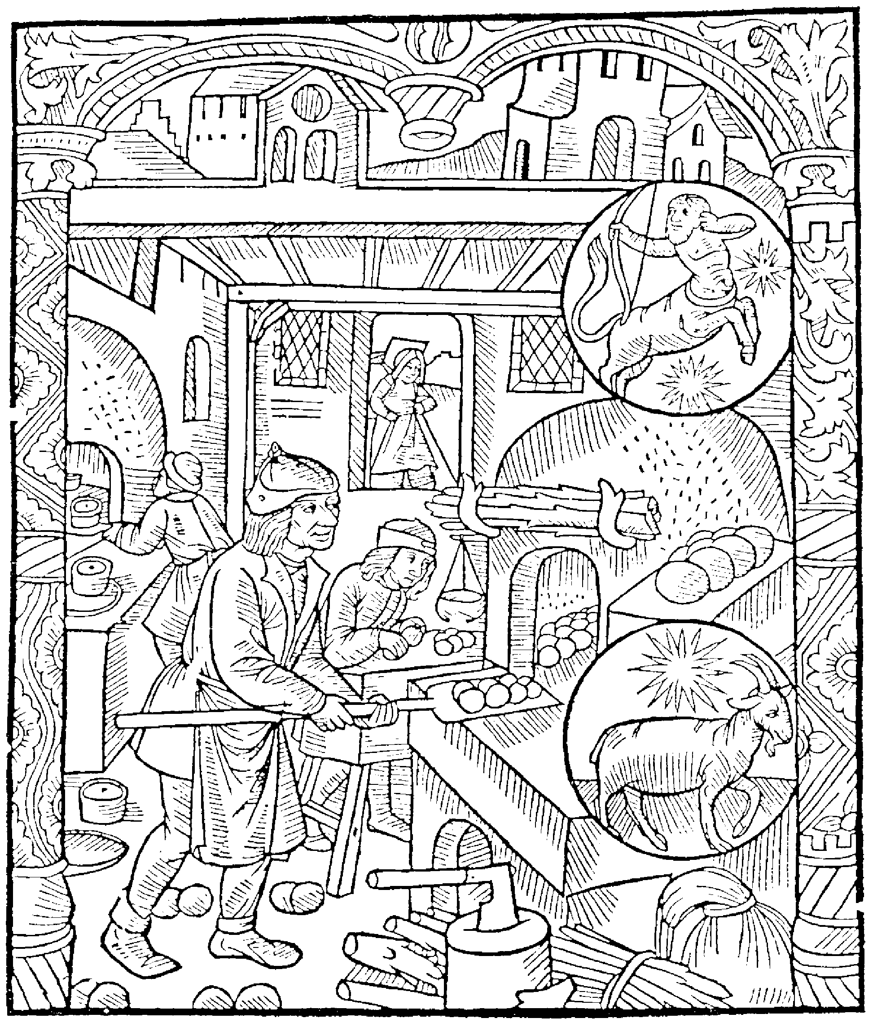
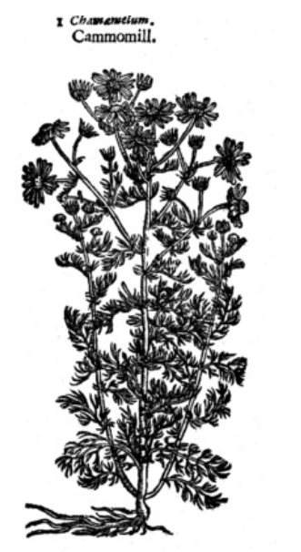

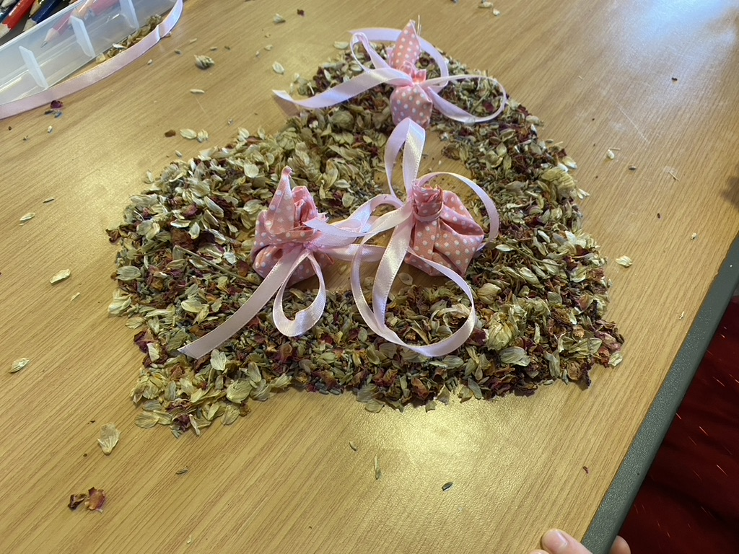
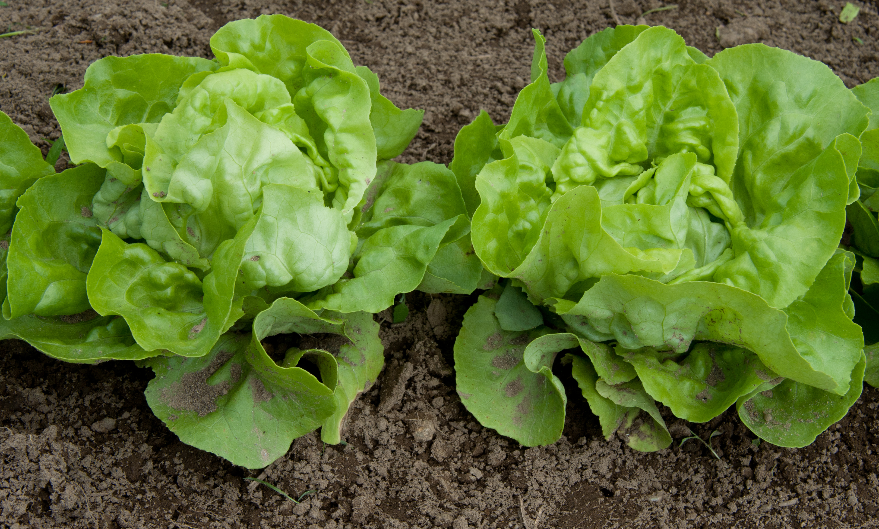

My Sleep Book

Slide 2
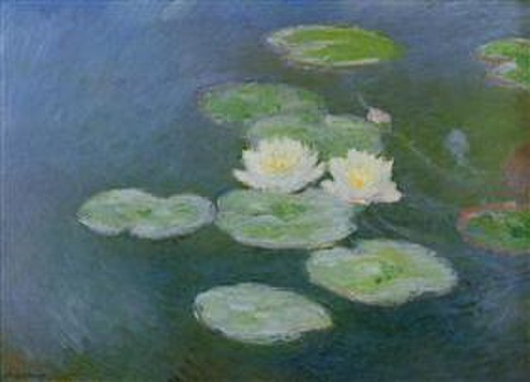
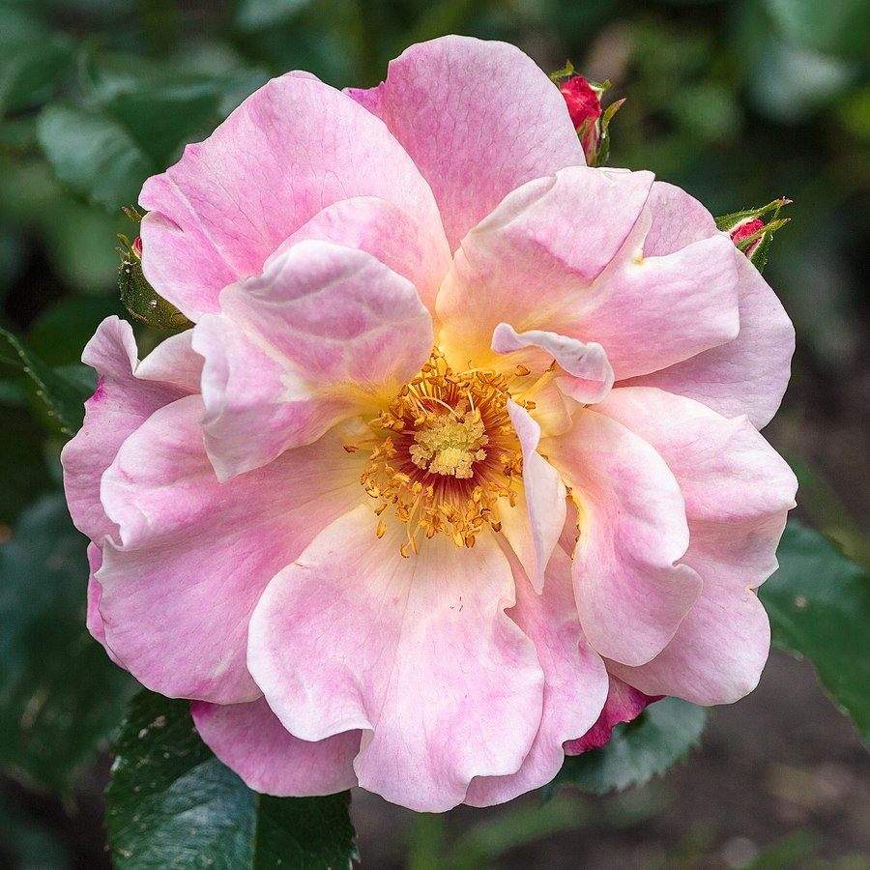
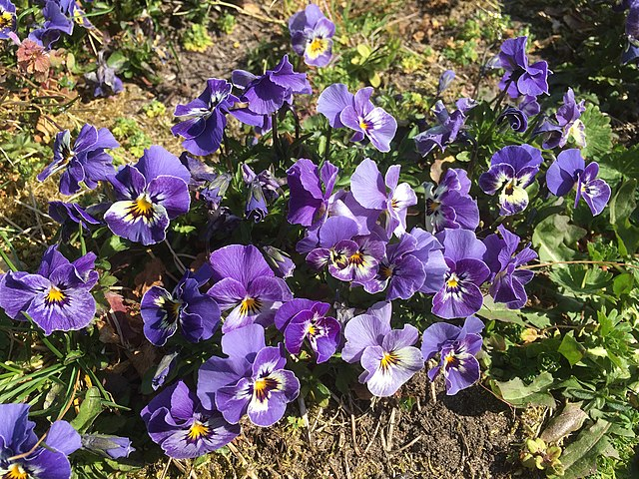
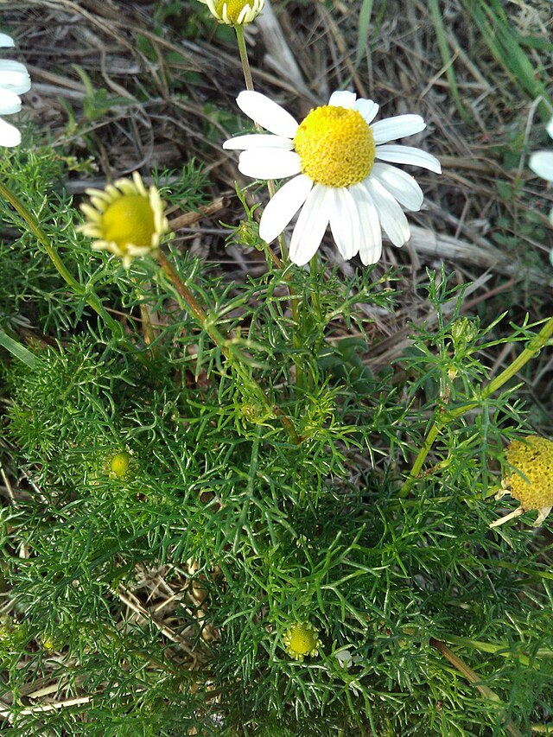

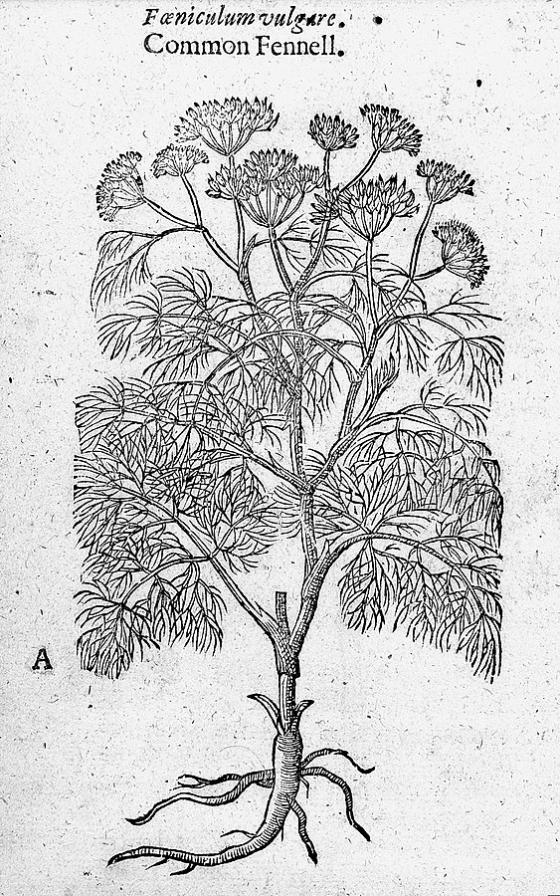
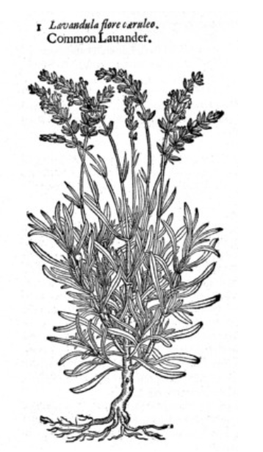
Sleepy Herbs and Flowers
Waterlilies by Claude Monet
Roses
Pansies and violets
Camomile
Cowslips

Slide 3

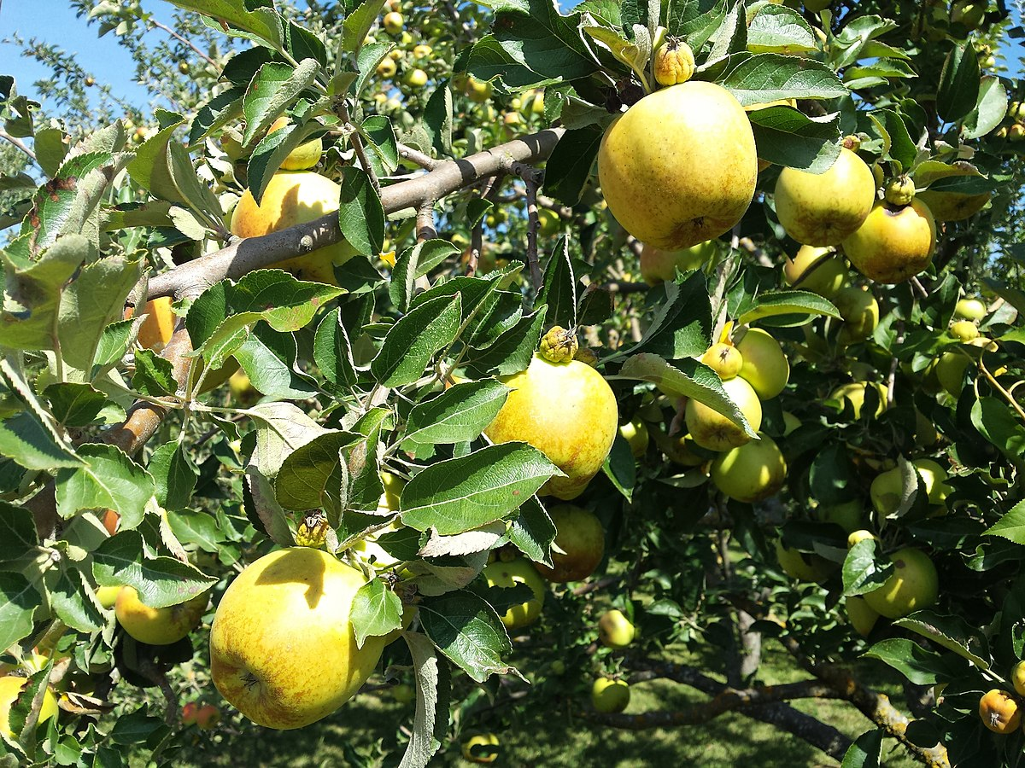
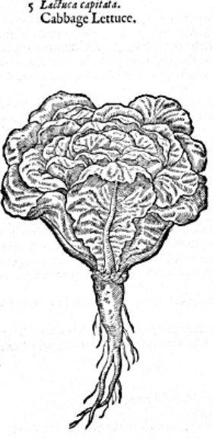
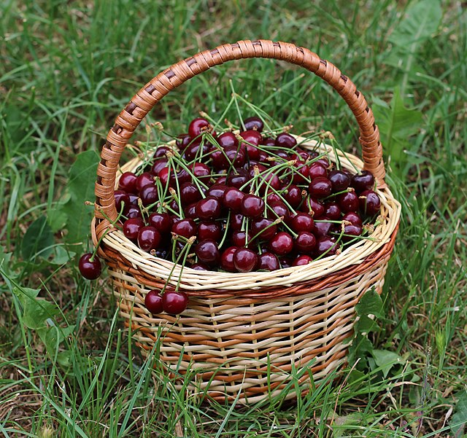
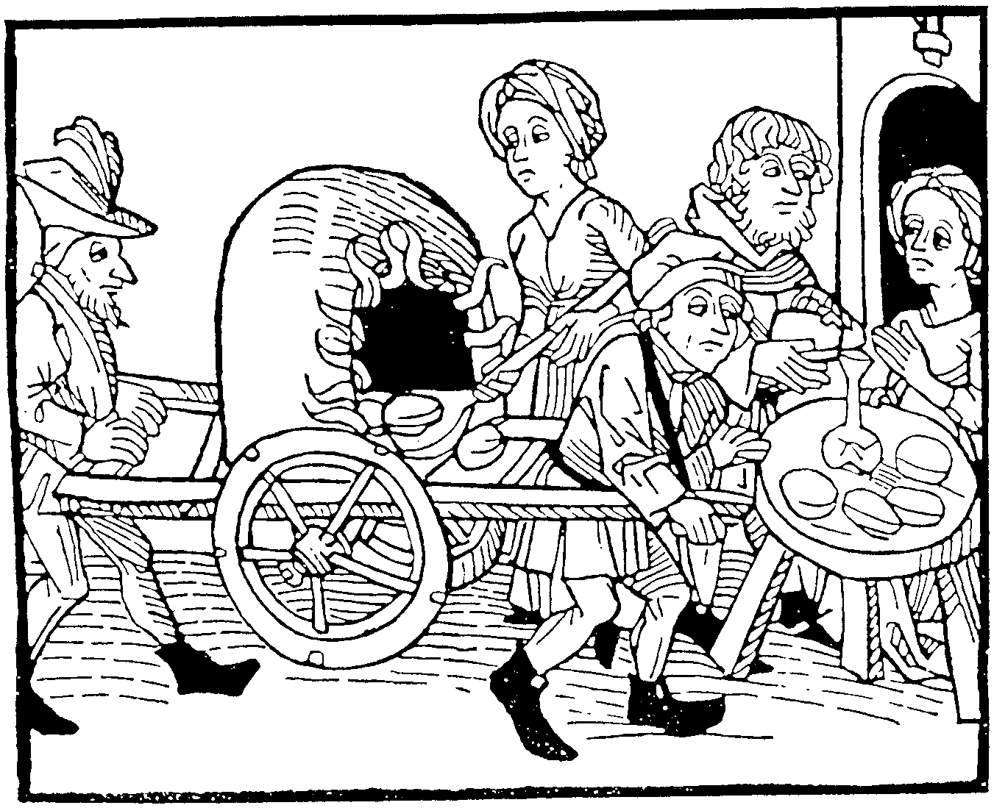
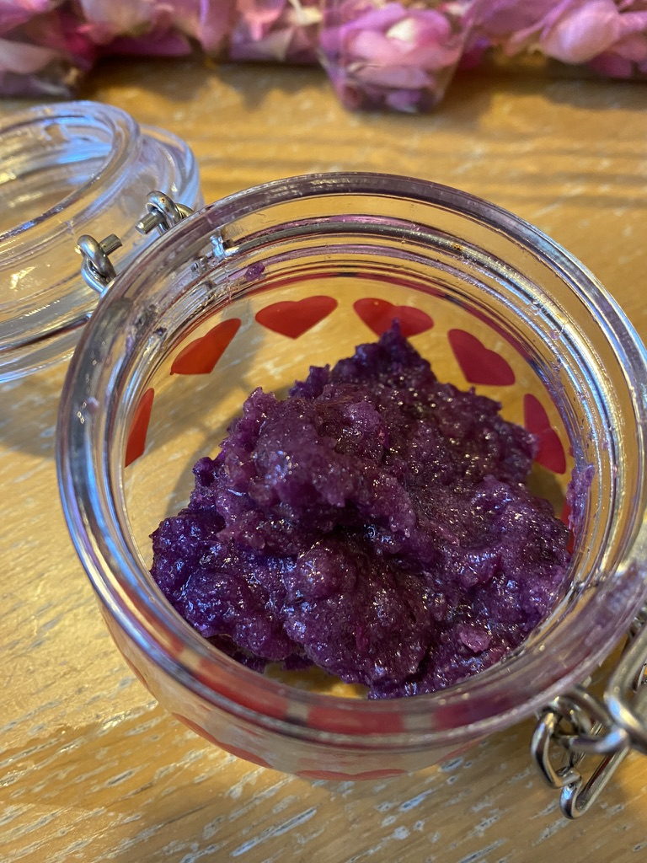
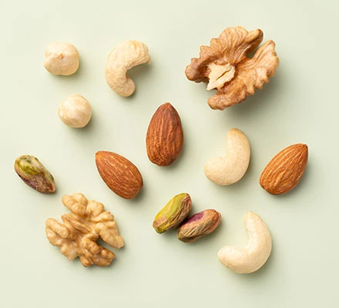
Sleepy Foods
Add your recipes and sleepy food ideas:
Which sleepy foods were available to the Tudors and Stuarts and which can we use to help us sleep today?

Slide 4
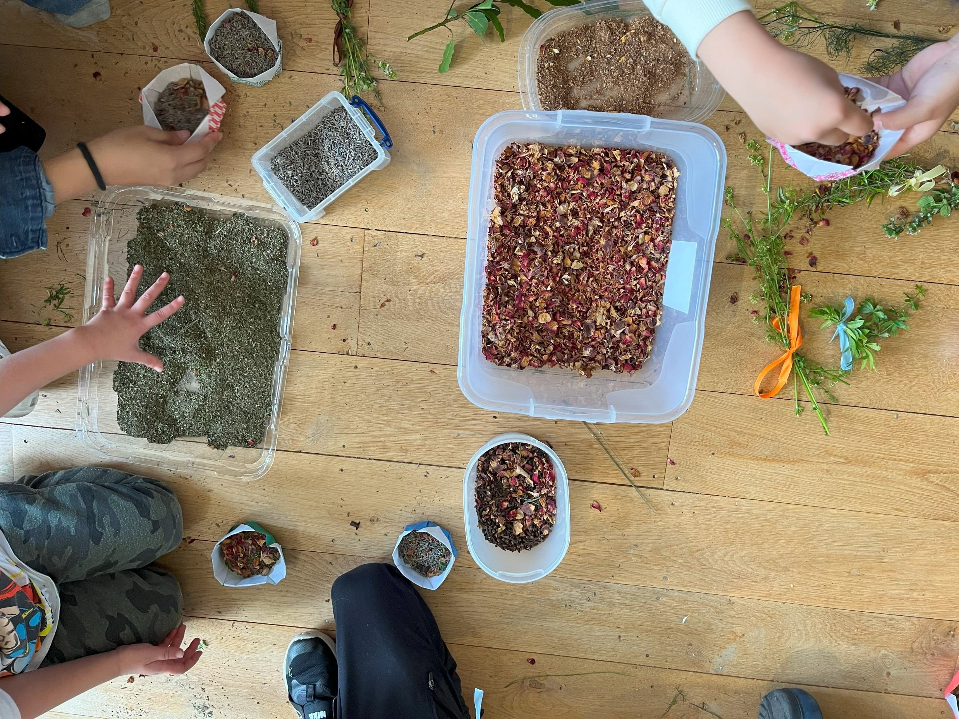
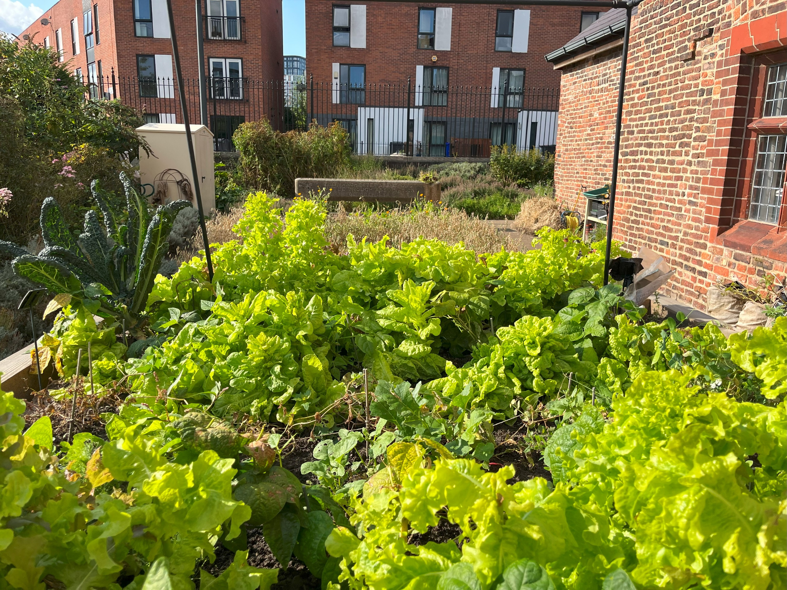
Sleep Remedies
Write your instructions…
Lettuce poultice
Scent bags

Slide 5
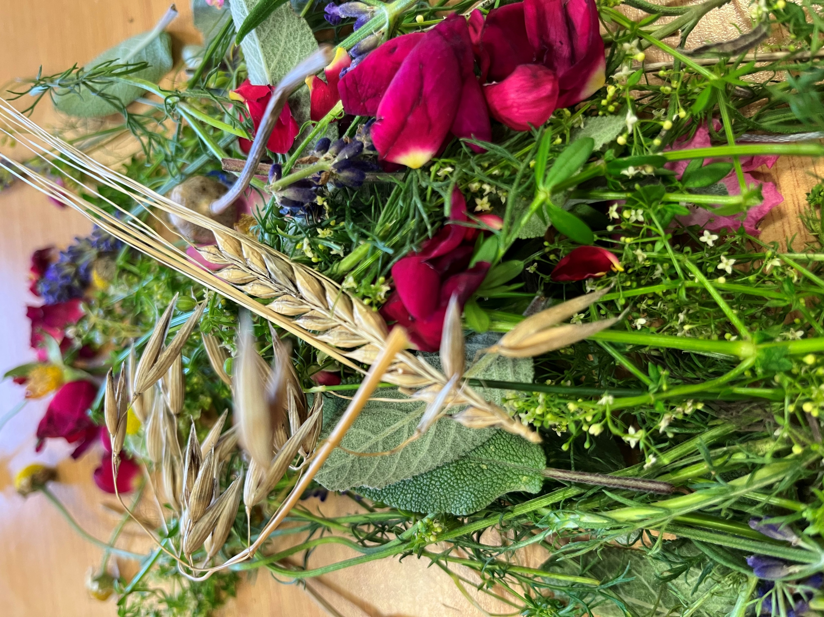
In my sleep garden there is…
I have chosen these features because…

Slide 6
Tudor sleep tips
My sleep and bedtime tips…
Nature / time outdoors
Soothing sounds
Cooler bedroom
Nice relaxing smells
Reading
Diaries – get things off
your chest, record your
thoughts
Low light
7-9 hours sleep a night

Slide 7
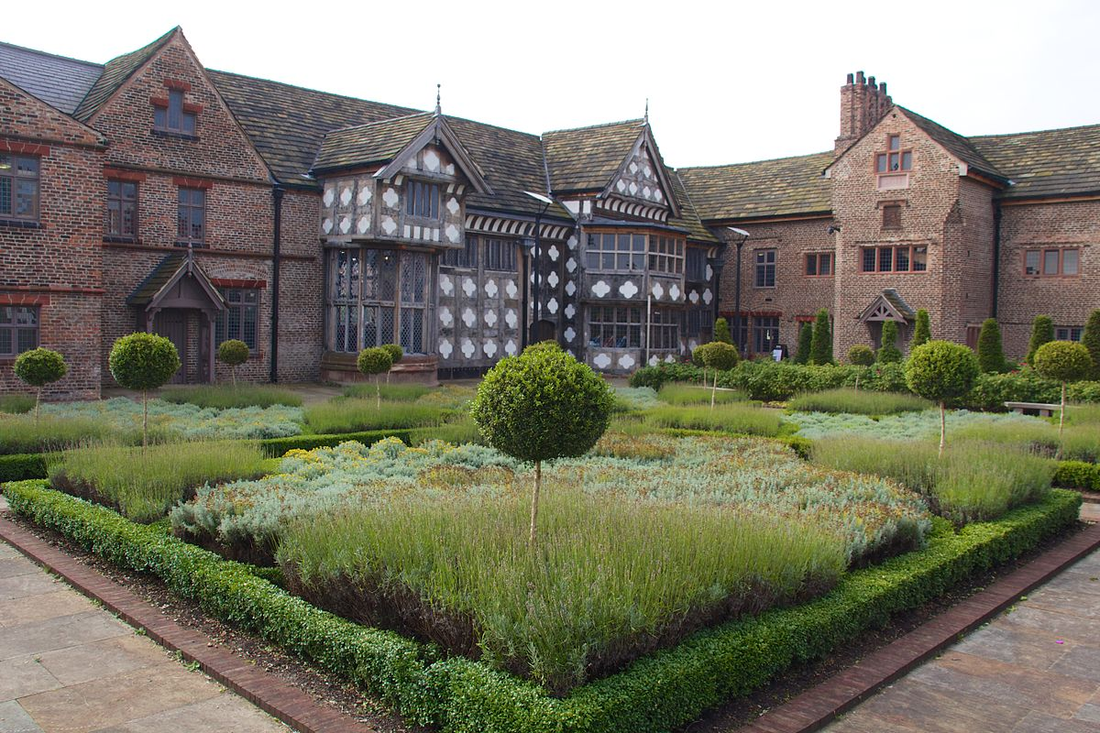
Ordsall Hall
Radclyffe family – Tudors and Stuarts – 16th and 17th century
Gardens – in the gardens at Ordsall there are… You can…
Tudor beds…
Kitchens…

Slide 8
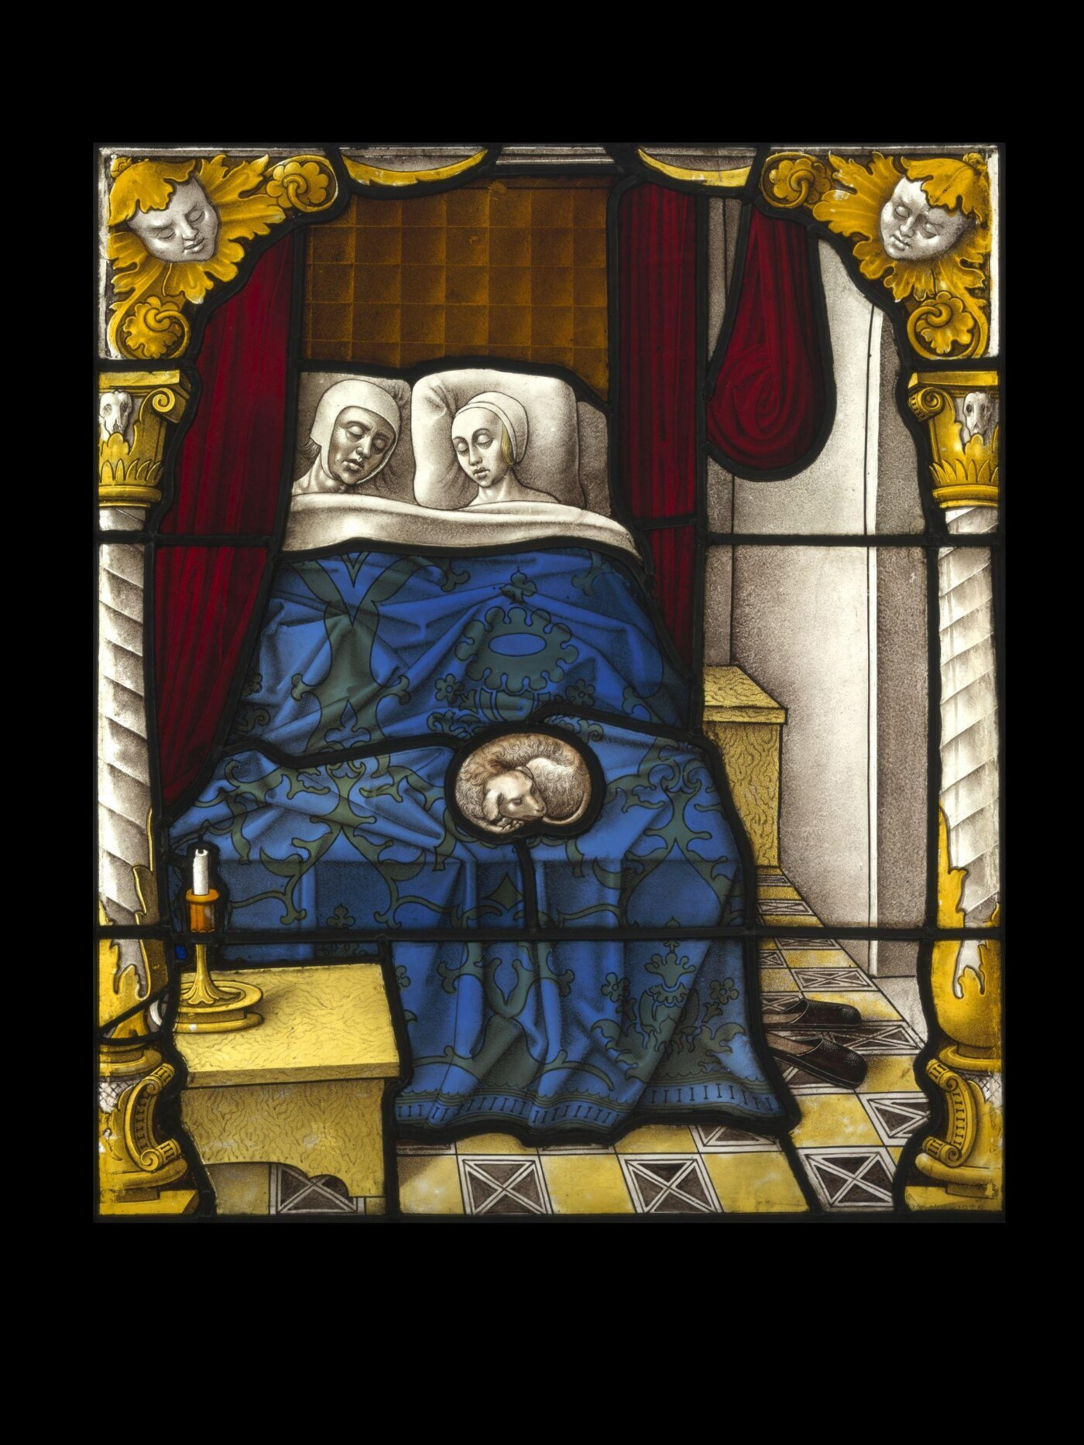
Why it is important to sleep well?

