Slide 1
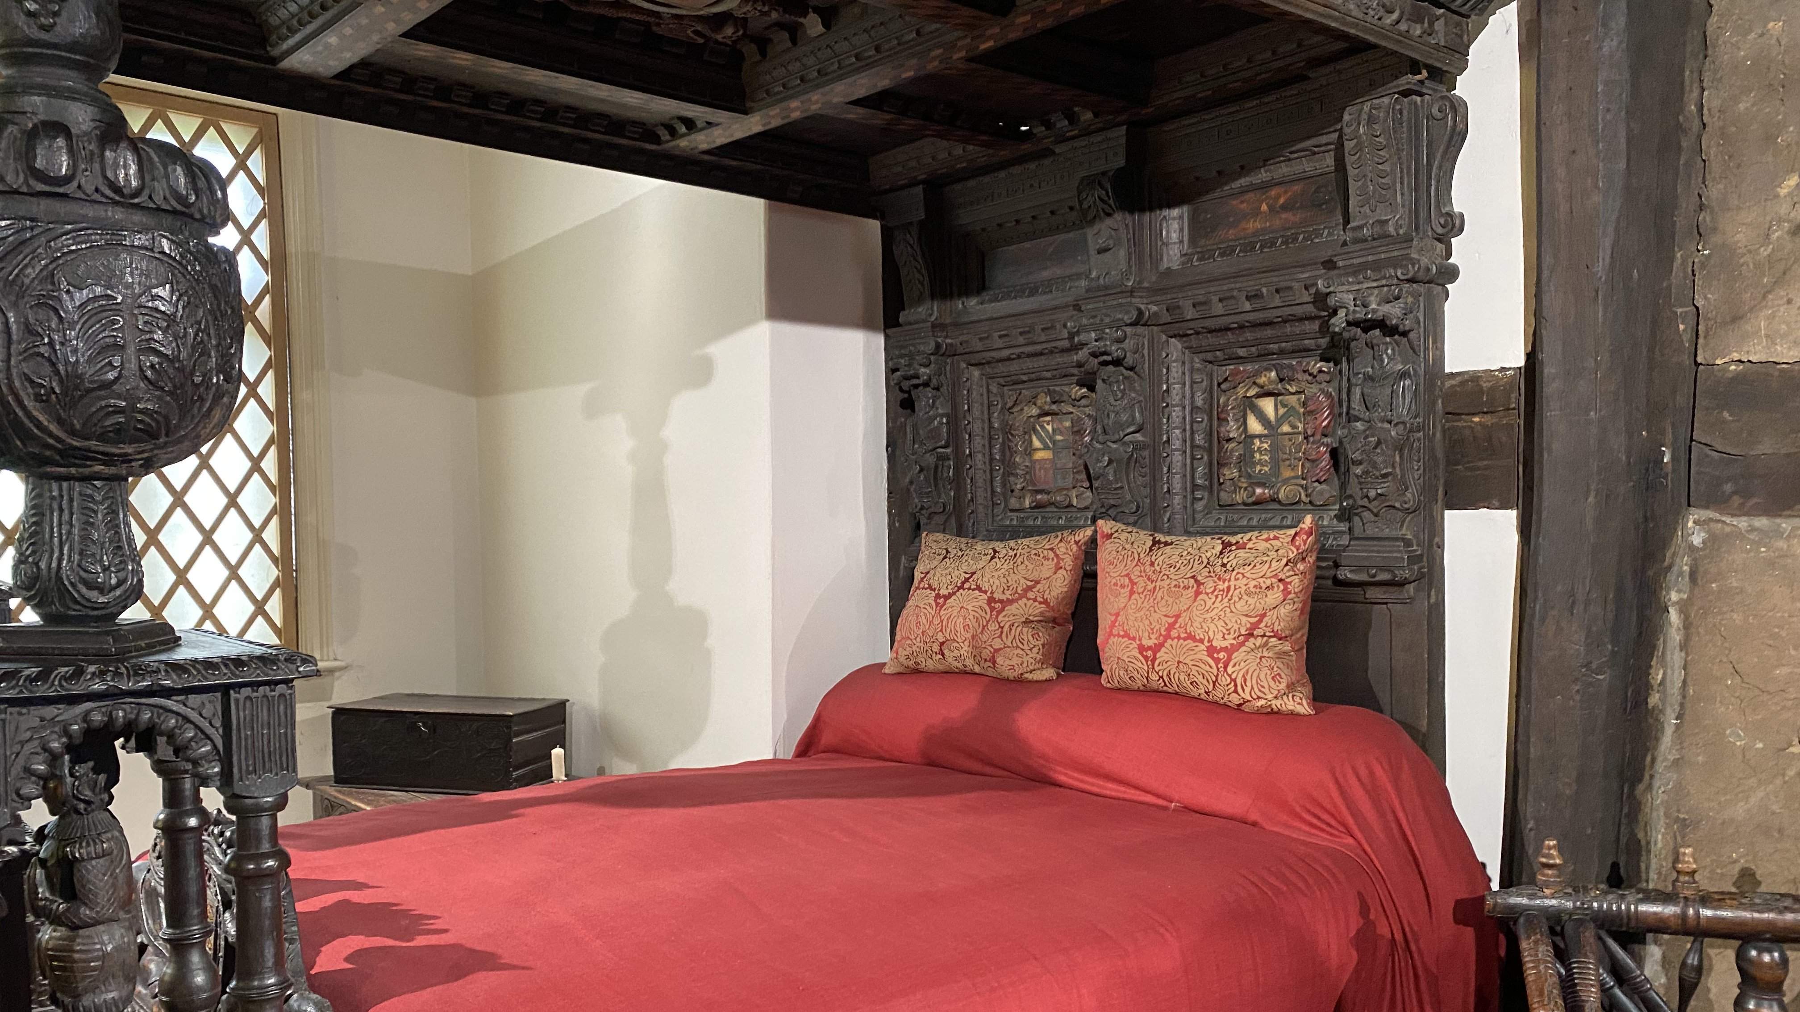

Sleeping Well at Ordsall Hall
KS2 School Resources
Sleep

Slide 2
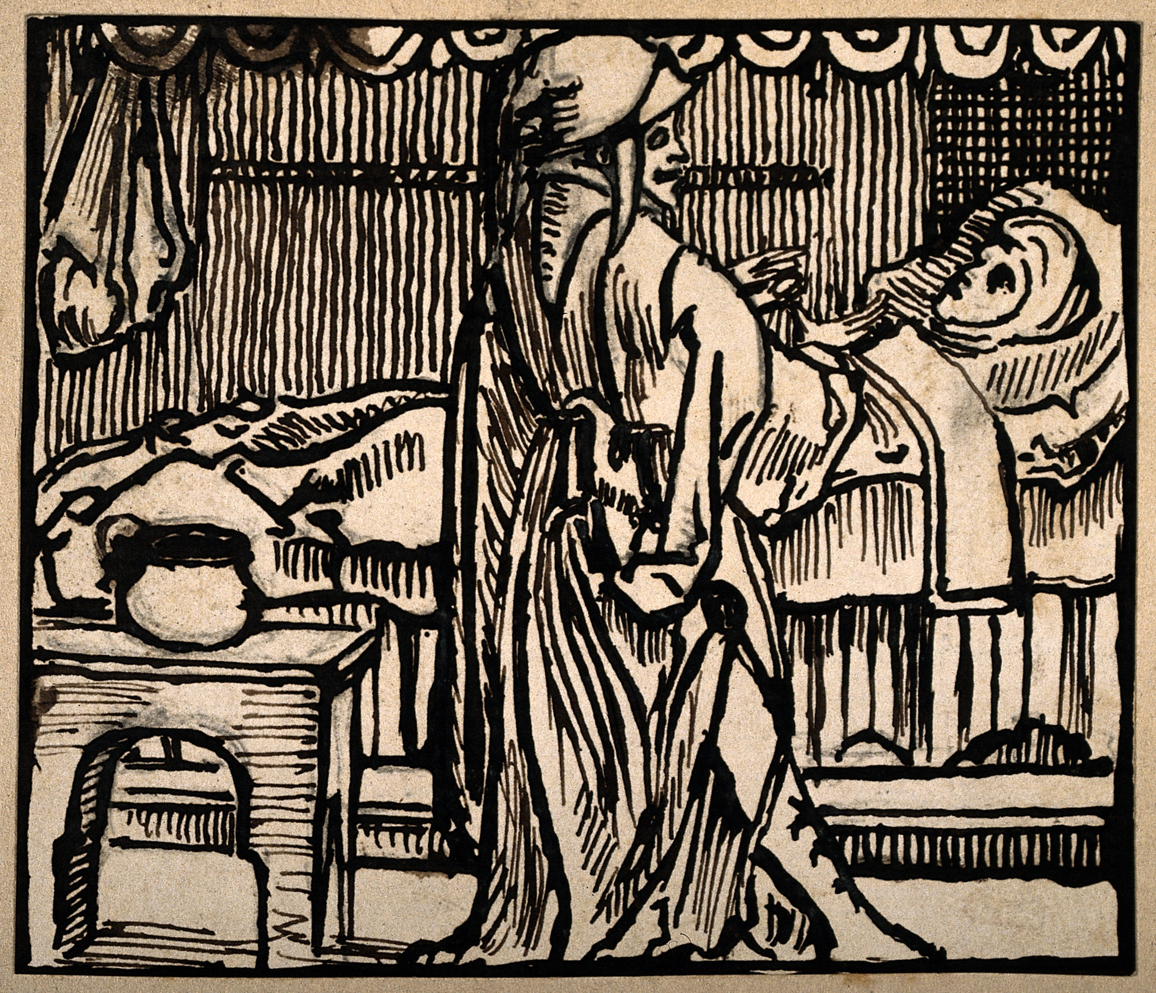
Sleep
Daily life and a person’s surroundings were thought to affect their sleep
Good sleep meant keeping the humours balanced through good habits

Slide 3




Sleepy Foods and Winding Down
Milk
Flowers and herbs
Going for a walk
Cabbage
Beans
Too much excitement

Slide 4

Scent
Roses
Lavender
Camomile
Lemon balm
Cinnamon
Nutmeg

Slide 5
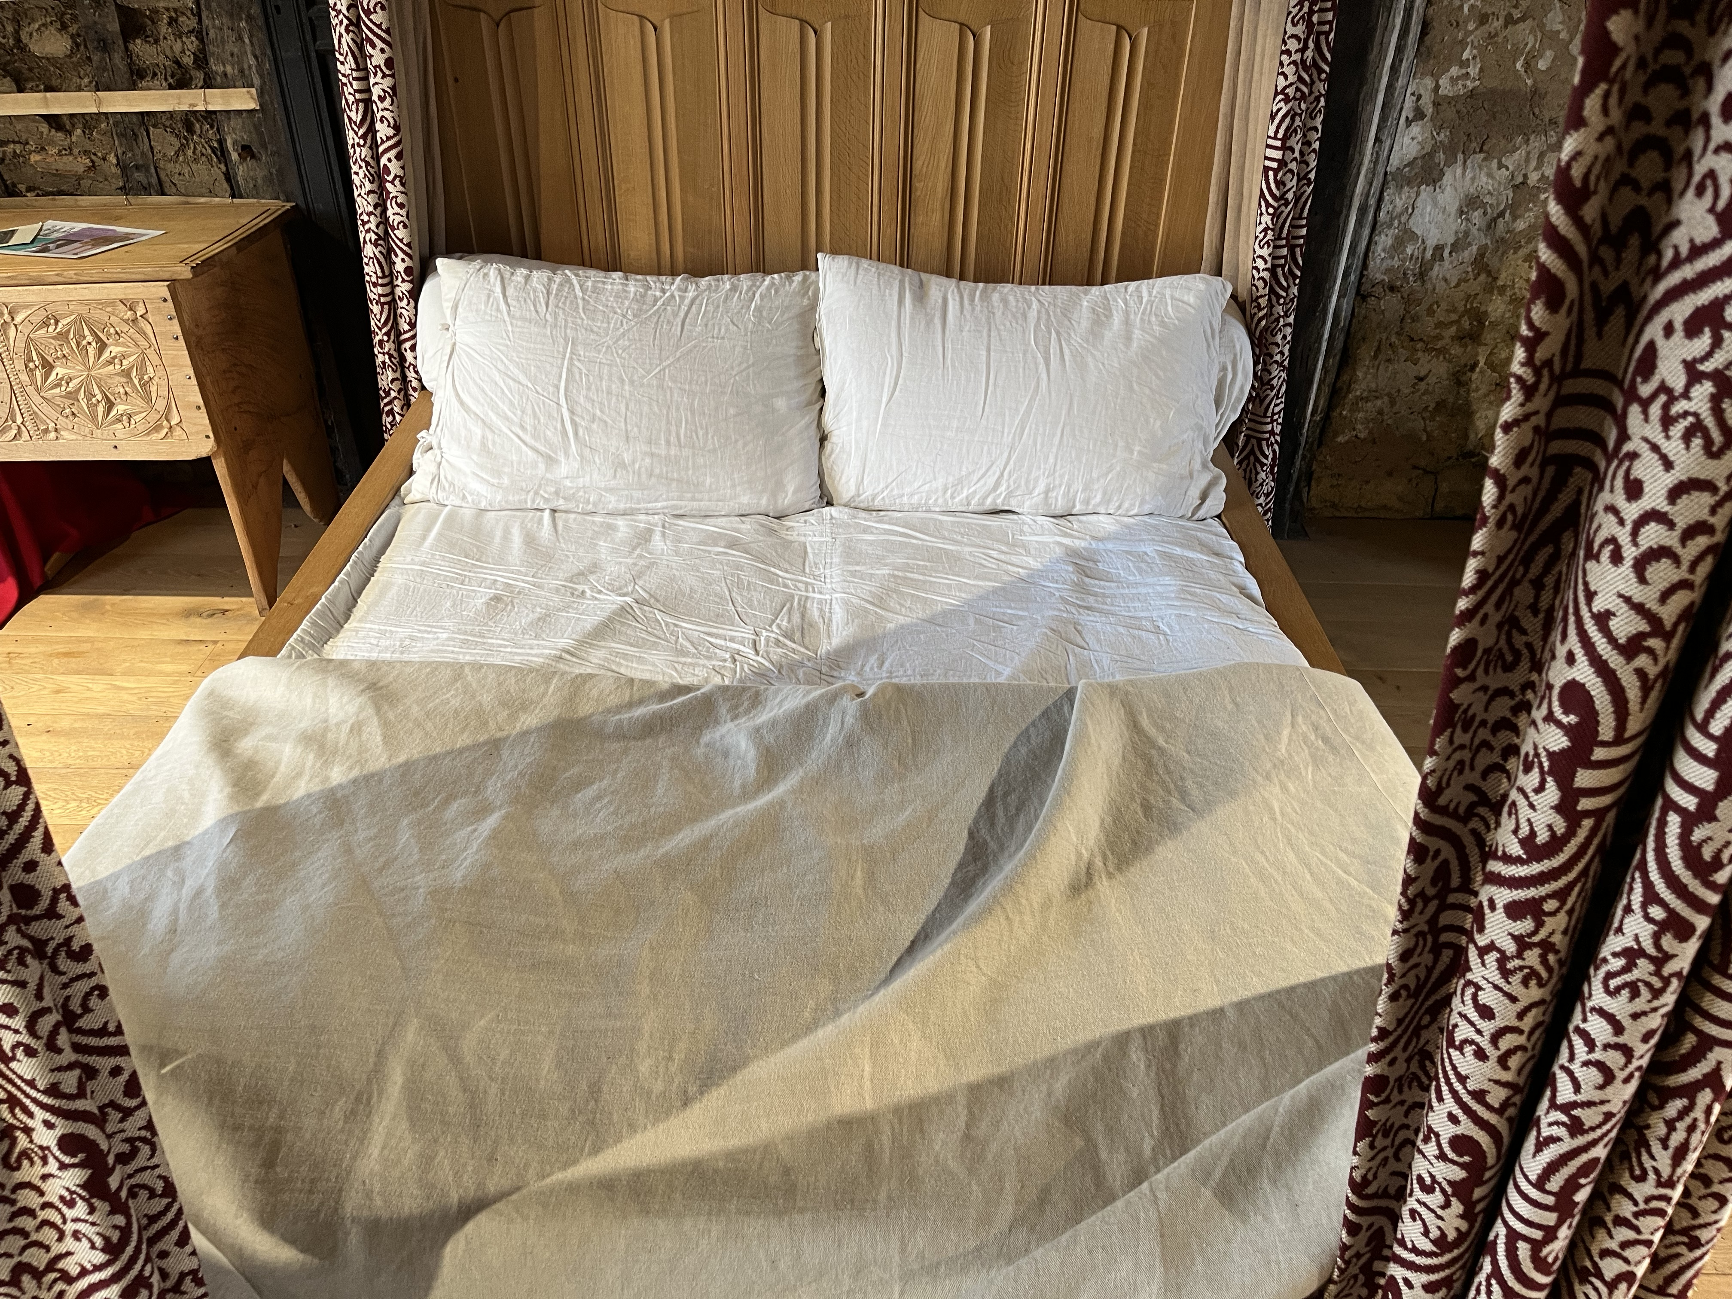
Emotional Health
Comfort
Reassurance
Safety

Slide 6
Bedtime Routines
What do you do before bed?
What time is bedtime?
What do you need to be able to sleep?
Hot drink?
Story?
Teddy?

Slide 7
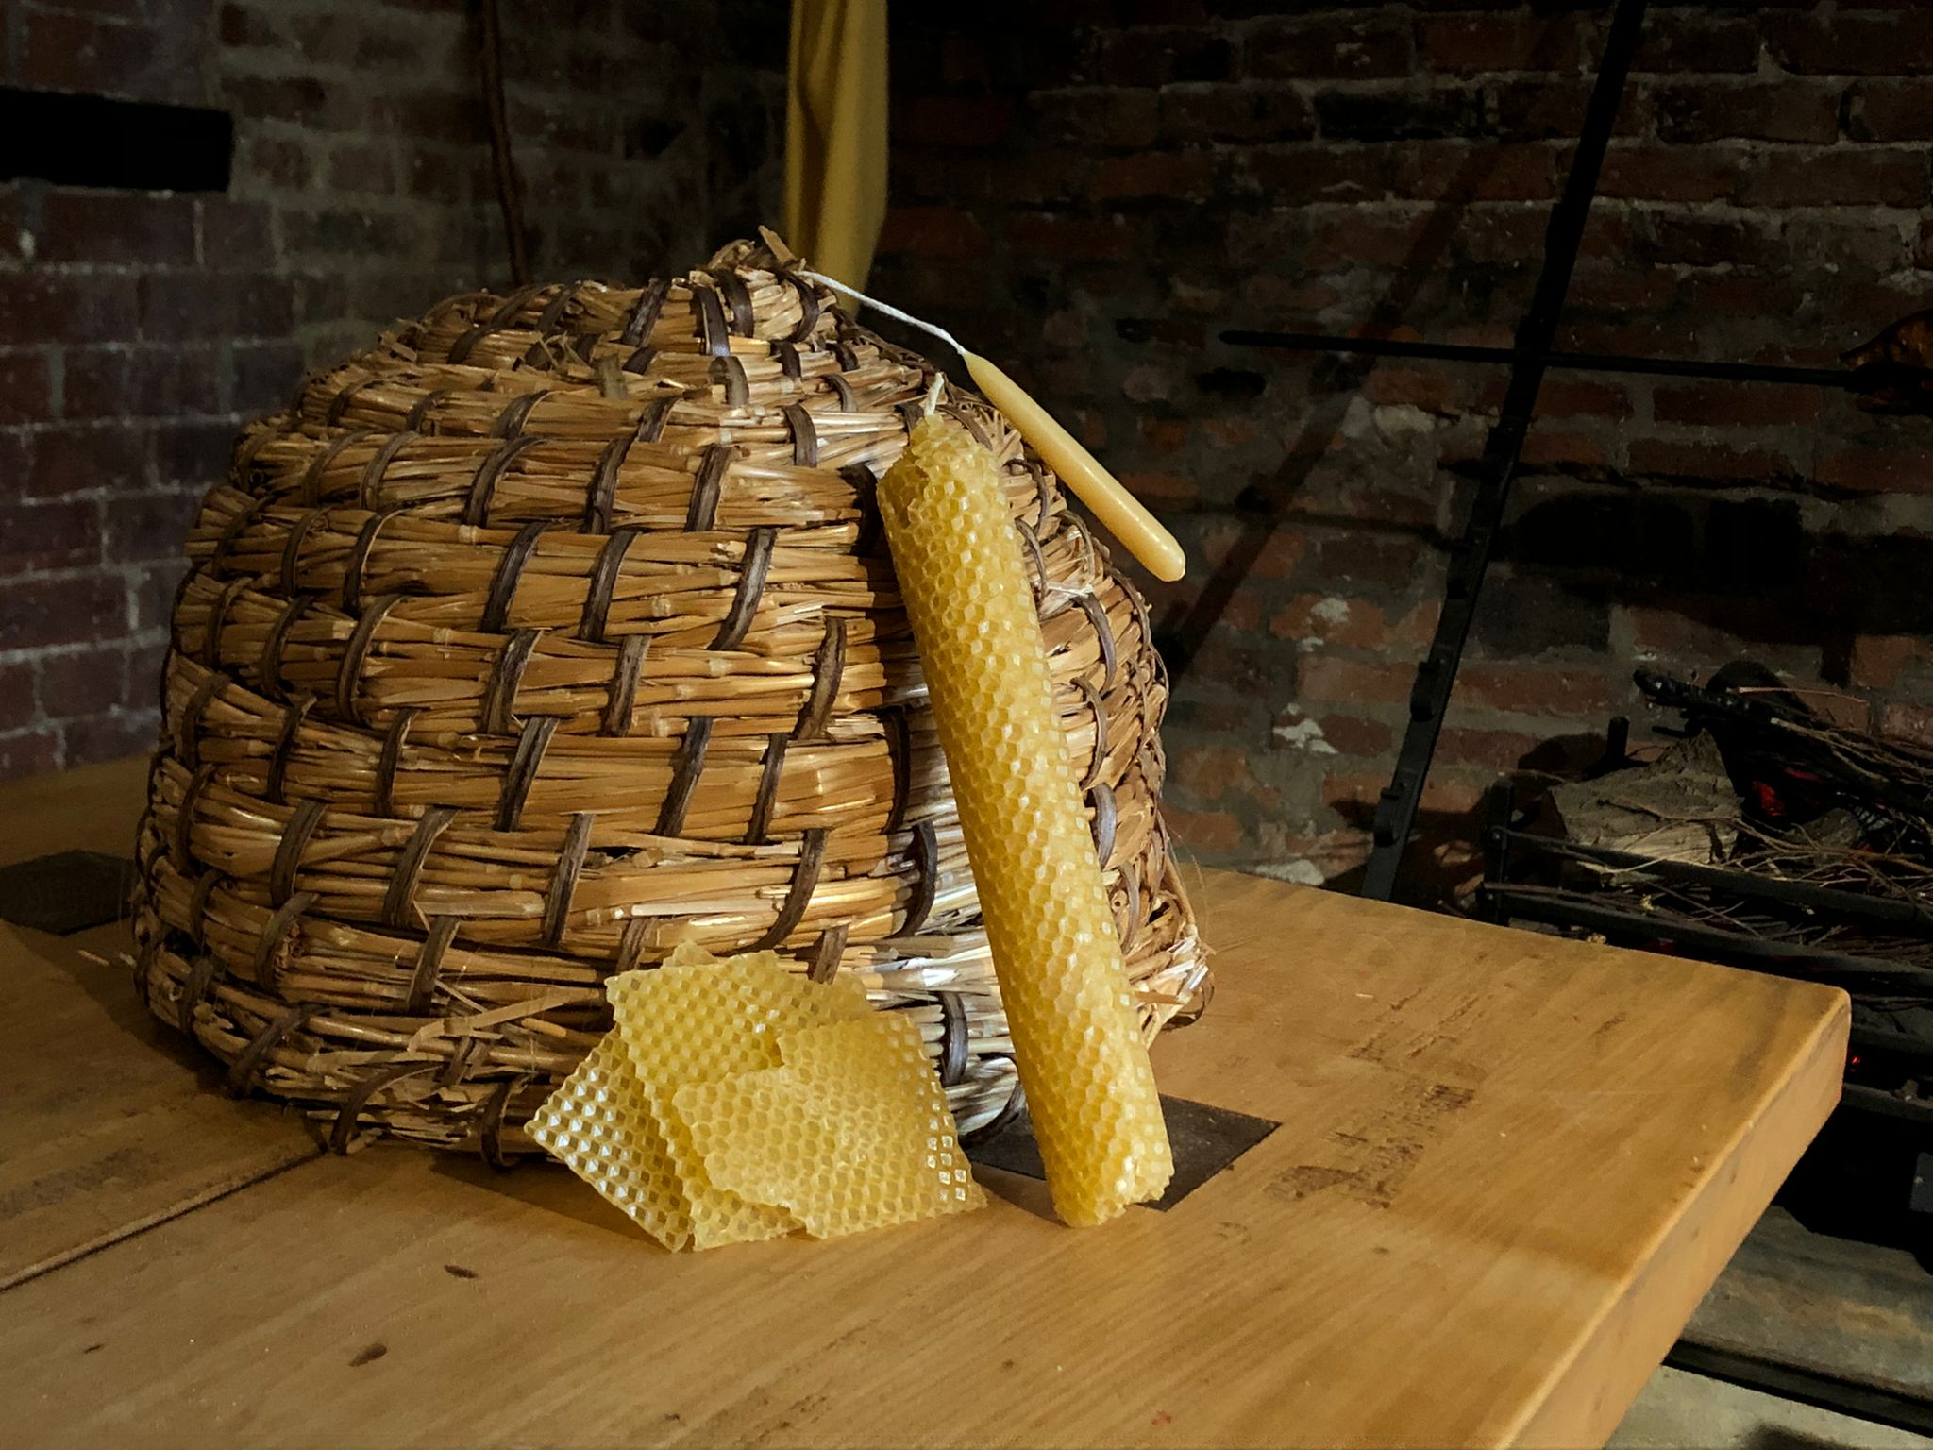
Sleep Tips and Next Steps
Cooler bedrooms
Lettuce
Herbs and flowers
Sleepy drinks
Low light
Try some activities where you can explore some of this historical advice and learn more about Tudor and Stuart approaches to sleep and health.

