Slide 1
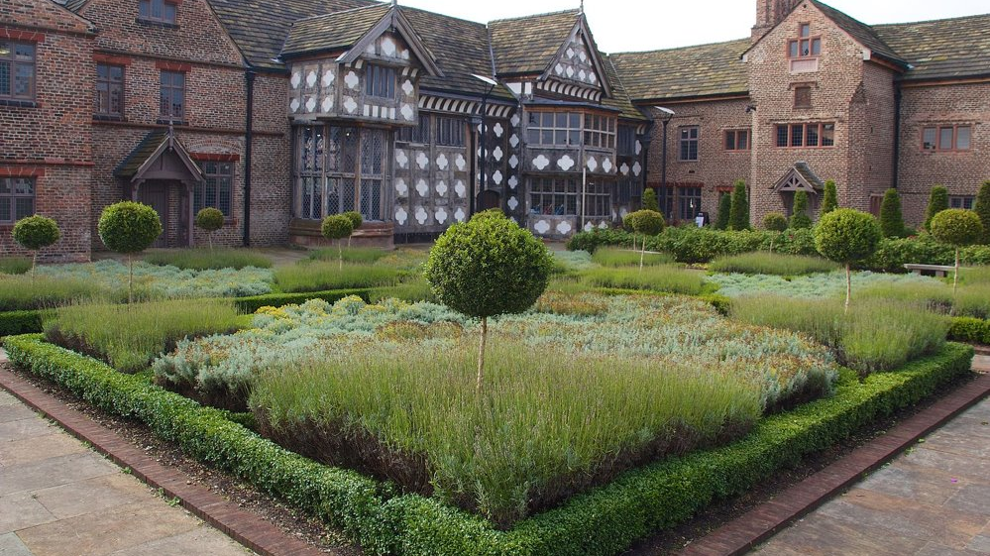

Sleeping Well at Ordsall Hall
Introduction
Key Stage 2 Schools

Slide 2

Sleeping like a Tudor
Ordsall Hall, Salford, home of the Radclyffe family
The Tudors and Stuarts looked after their sleep by paying attention to their bodies, minds, and the natural environment all around them.

Slide 3
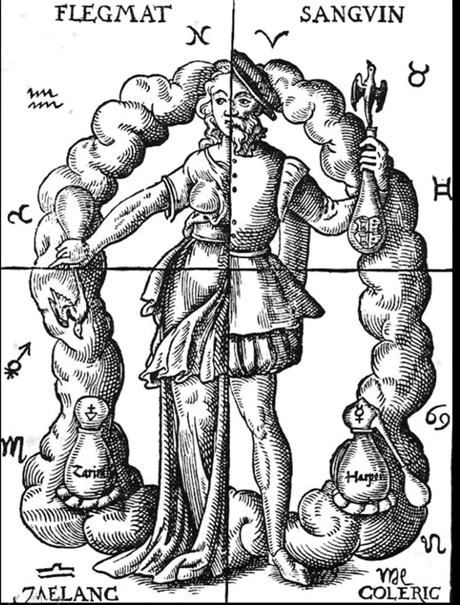
The Four Humours
They looked after their ‘humours’ – gases and fluids they thought moved around their bodies.
Blood
Phlegm
Choler
Melancholy

Slide 4
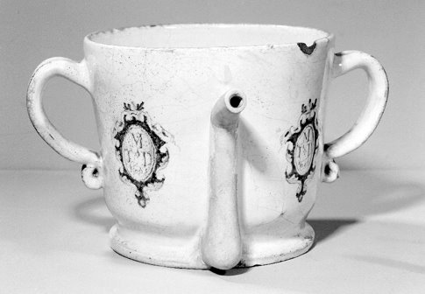


The Six Non-naturals
Balance in everyday life was thought to keep people healthy
  Sleep
  Food and drink
  Exercise and rest
  Air
  Excretion and retention
  Passions of the mind
Posset pot

Slide 5
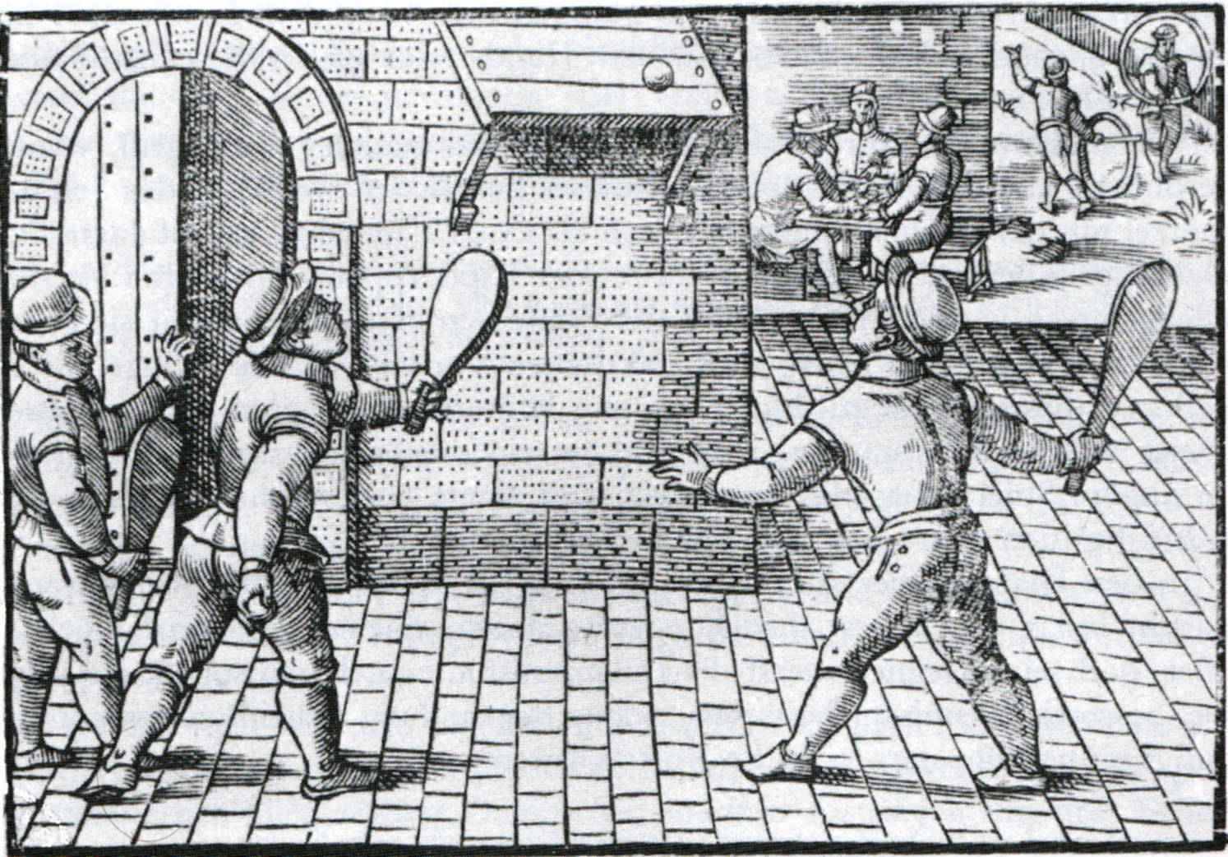
Balanced Lifestyles
Think about these questions
as a class:
  Do you sleep well?
  Is your diet healthy?
  How much time do you spend outdoors?
  What do you do to relax?
  How do you look after your emotional health?

